Slide 1

Cooking
Merit Badge
Troop 344 & 9344
Pemberville, OH

Slide 2

Requirements
Health and Safety. Do the following:
  Explain to your counselor the most likely hazards you may encounter while participating in cooking activities and what you should do to anticipate, help prevent, mitigate, and respond to these hazards
  Show that you know first aid for and how to prevent injuries or illnesses that could occur while preparing meals and eating, including burns and scalds, cuts, choking, and allergic reactions.
  Describe how meat, fish, chicken, eggs, dairy products, and fresh vegetables should be stored, transported, and properly prepared for cooking. Explain how to prevent cross-contamination.
  Discuss with your counselor food allergies, food intolerance, and food-related illnesses and diseases. Explain why someone who handles or prepares food needs to be aware of these concerns.
  Discuss with your counselor why reading food labels is important. Explain how to identify common allergens such as peanuts, tree nuts, milk, eggs, wheat, soy, and shellfish.

Slide 3
Requirements
Nutrition. Do the following:
  Using the MyPlate food guide or the current USDA nutrition model, give five examples for EACH of the following food groups, the recommended number of daily servings, and the recommended serving size:
    Fruits
    Vegetables
    Grains
    Proteins
    Dairy
  Explain why you should limit your intake of oils and sugars.
  Determine your daily level of activity and your caloric need based on your activity level. Then, based on the MyPlate food guide, discuss with your counselor an appropriate meal plan for yourself for one day.
  Discuss your current eating habits with your counselor and what you can do to eat healthier, based on the MyPlate food guide.
  Discuss the following food label terms: calorie, fat, saturated fat, trans fat, cholesterol, sodium, carbohydrate, dietary fiber, sugar, protein. Explain how to calculate total carbohydrates and nutritional values for two servings, based on the serving size specified on the label.

Slide 4
Requirements
Cooking Basics. Do the following:
  Discuss the following cooking methods. For each one, describe the equipment needed, how temperature control is maintained, and name at least one food that can be cooked using that method: baking, boiling, broiling, pan frying, simmering, microwaving, air frying, grilling, foil cooking, Dutch oven.
  Discuss the benefits of using a camp stove on an outing vs. a charcoal or wood fire.
  Describe with your counselor how to manage your time when preparing a meal so components for each course are ready to serve at the same time.
  Explain and give examples of how taste, texture, and smell impact what we eat.

Slide 5
Requirements
Cooking at Home. Using the MyPlate food guide or the current USDA nutrition model, plan a menu for three full days of meals (three breakfasts, three lunches, and three dinners) plus one dessert. Your menu should include enough to feed yourself and at least one adult, keeping in mind any special needs (such as food allergies) and how you kept your foods safe and free from cross-contamination. List the equipment and utensils needed to prepare and serve these meals.
Then do the following:
  Create a shopping list for your meals showing the amount of food needed to prepare and serve each meal, and the cost for each meal.
  Share and discuss your meal plan and shopping list with your counselor.

Slide 6
Requirements
Cooking at Home. Using the MyPlate food guide or the current USDA nutrition model, plan a menu for three full days of meals (three breakfasts, three lunches, and three dinners) plus one dessert. Your menu should include enough to feed yourself and at least one adult, keeping in mind any special needs (such as food allergies) and how you kept your foods safe and free from cross-contamination. List the equipment and utensils needed to prepare and serve these meals.
Then do the following:
  Using at least five of the 10 cooking methods from requirement 3, prepare and serve yourself and at least one adult (parent, family member, guardian, or other responsible adult) one breakfast, one lunch, one dinner, and one dessert from the meals you planned.
  Time your cooking to have each meal ready to serve at the proper time. Have an adult verify the preparation of the meal to your counselor.
  After each meal, ask a person you served to evaluate the meal on presentation and taste, then evaluate your own meal. Discuss what you learned with your counselor, including any adjustments that could have improved or enhanced your meals. Tell how better planning and preparation help ensure a successful meal.

Slide 7
Requirements
Camp Cooking. Do the following:
  Using the MyPlate food guide or the current USDA nutrition model, plan a menu that includes four meals, one snack, and one dessert for your patrol (or a similar size group of up to eight youth, including you) on a camping trip. These four meals must include two breakfasts, one lunch, and one dinner. Additionally, you must plan one snack and one dessert. Your menus should include enough food for each person, keeping in mind any special needs (such as food allergies) and how you keep your foods safe and free from cross-contamination. List the equipment and utensils needed to prepare and serve these meals.
  Find or create recipes for the four meals, the snack, and the dessert you have planned. Adjust menu items in the recipes for the number to be served. Create a shopping list and budget to determine the per-person cost.
  Share and discuss your menu plans and shopping list with your counselor.

Slide 8
Requirements
Camp Cooking. Do the following:
  In the outdoors, using your menu plans and recipes for this requirement, cook two of the four meals you planned using either a camp stove OR backpacking stove. Use a skillet OR a Dutch oven over campfire coals for the third meal, and cook the fourth meal in a foil pack OR on a skewer. Serve all of these meals to your patrol or a group of youth.**
  In the outdoors, using your menu plans and recipes for this requirement, prepare one snack and one dessert. Serve both of these to your patrol or a group of youth.**
  After each meal, have those you served evaluate the meal on presentation and taste, and then evaluate your own meal. Discuss what you learned with your counselor, including any adjustments that could have improved or enhanced your meals. Tell how planning and preparation help ensure successful outdoor cooking.
  **Where local regulations do not allow you to build a fire, the counselor may adjust the requirement to meet the law. The meals in requirements 5 and 6 may be prepared for different trips and need not be prepared consecutively. Scouts working on this badge in summer camp should take into consideration foods that can be obtained at the camp commissary.

Slide 9
Requirements
Camp Cooking. Do the following:
  Explain to your counselor how you cleaned the equipment, utensils, and the cooking site thoroughly after each meal. Explain how you properly disposed of dishwater and of all garbage.
  Discuss how you followed the Outdoor Code and no-trace principles when preparing your meals.

Slide 10
Requirements
Trail and backpacking meals. Do the following:
  Using the MyPlate food guide or the current USDA nutrition model, plan a menu for trail hiking or backpacking that includes one breakfast, one lunch, one dinner, and one snack. These meals must not require refrigeration and are to be consumed by three to five people (including you). Be sure to keep in mind any special needs (such as food allergies) and how you will keep your foods safe and free from cross-contamination. List the equipment and utensils needed to prepare and serve these meals.
  Create a shopping list for your meals, showing the amount of food needed to prepare and serve each meal, and the cost for each meal.
  Share and discuss your meal plan and shopping list with your counselor. Your plan must include how to repackage foods for your hike or backpacking trip to eliminate as much bulk, weight, and garbage as possible.

Slide 11
Requirements
Trail and backpacking meals. Do the following:
  While on a trail hike or backpacking trip, prepare and serve two meals and a snack from the menu planned for this requirement. At least one of those meals must be cooked over a fire, or an approved trail stove (with proper supervision).**
  After each meal, have those you served evaluate the meal on presentation and taste, then evaluate your own meal. Discuss what you learned with your counselor, including any adjustments that could have improved or enhanced your meals. Tell how planning and preparation help ensure successful trail hiking or backpacking meals.
  Discuss how you followed the Outdoor Code and no-trace principles during your outing. Explain to your counselor how you cleaned any equipment, utensils, and the cooking site after each meal. Explain how you properly disposed of any dishwater and packed out all garbage.
  **Where local regulations do not allow you to build a fire, the counselor may adjust the requirement to meet the law. The meals in requirements 5 and 6 may be prepared for different trips and need not be prepared consecutively. Scouts working on this badge in summer camp should take into consideration foods that can be obtained at the camp commissary.

Slide 12
Requirements
Careers and Hobbies. Do ONE of the following:
  a. Identify three career opportunities that would use skills and knowledge in cooking. Pick one and research the training, education, certification requirements, experience, and expenses associated with entering the field. Research the prospects for employment, starting salary, advancement opportunities and career goals associated with this career. Discuss what you learned with your counselor and whether you might be interested in this career.
  b. Identify how you might use the skills and knowledge in cooking to pursue a personal hobby or healthy lifestyle. Research the additional training required, expenses, and affiliation with organizations that would help you maximize the enjoyment and benefit you might gain from it. Discuss what you learned with your counselor and share what short-term and long-term goals you might have if you pursued this.

Slide 13

Basics of Cooking
Safety
Food Nutrition
Meal Planning
Food Preparation

Slide 14
Safety

Slide 15
Requirements
Health and Safety. Do the following:
  Explain to your counselor the most likely hazards you may encounter while participating in cooking activities and what you should do to anticipate, help prevent, mitigate, and respond to these hazards
  Show that you know first aid for and how to prevent injuries or illnesses that could occur while preparing meals and eating, including burns and scalds, cuts, choking, and allergic reactions.
  Describe how meat, fish, chicken, eggs, dairy products, and fresh vegetables should be stored, transported, and properly prepared for cooking. Explain how to prevent cross-contamination.
  Discuss with your counselor food allergies, food intolerance, and food-related illnesses and diseases. Explain why someone who handles or prepares food needs to be aware of these concerns.
  Discuss with your counselor why reading food labels is important. Explain how to identify common allergens such as peanuts, tree nuts, milk, eggs, wheat, soy, and shellfish.

Slide 16
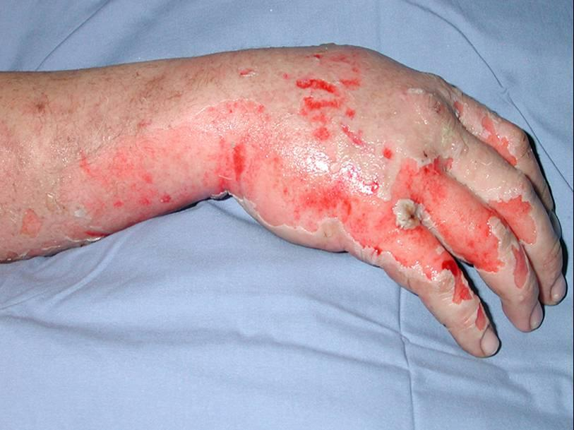
Heat Sources
Common Cooking Injuries
Burns and Scalds:
    Burns take place when contact is made with hot objects, chemicals, electrical sources, radiated heat, frozen surfaces, friction or radiation.
    Scalds are from boiling fluids or steam.

Slide 17
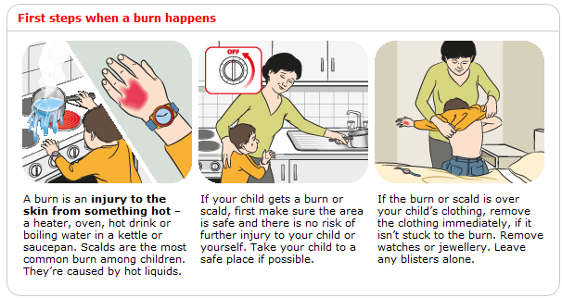
First Aid for Burns and Scalds

Slide 18
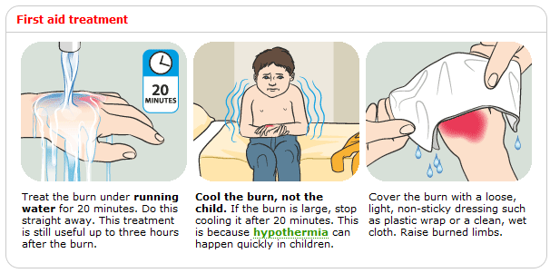
First Aid for Burns and Scalds

Slide 19
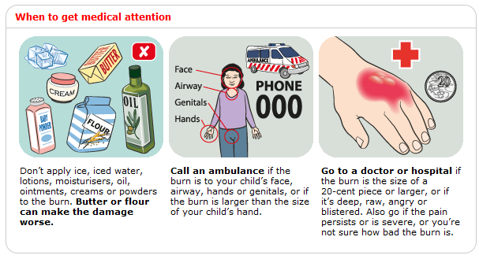
First Aid for Burns and Scalds

Slide 20
Heat Sources
Preventing Burn Injuries
Basic guidelines to follow when using heat to prepare foods:
    Do not leave a lit stove unattended.
    Dress appropriately when cooking; try not to wear loose clothing such as an open sweater or open jacket.
        You do not want anything to be able to dangle into fire/stove etc.
        Also possibly getting pulled in by a power kitchen tool or catching a pot on the stove.
    Keep stove/oven area clean.
    Do not keep towels, oven mitts, or pot holders close to heat source.

Slide 21
Heat Sources
Preventing Burn Injuries
Take time to prepare meals without rushing.
Always use pot holders that are in good repair.
Keep pot handles turned toward the back of the stove.
Cook on rear burners when ever possible, but avoid reaching over an open flame or hot burner.
Use caution when moving heavy pots of liquids from the stove.
Keep all heated liquid and food out of children’s reach, and never hold anything hot while carrying a child.

Slide 22
Heat Sources
Preventing Burn Injuries
In Camp
  Ensure camp stoves are working properly.
  Ensure all safety fire standards are adhered to when cooking around an open fire.
  Ensure pots/pans are stabilized in open fire area so as not to fall and burn anyone.
    Clear all flammable vegetation 5” from fire.
    Attend to fire at all times.
    Keep fire fighting tools handy (water and/or shovel).
    Leave fire only when it is out.

Slide 23
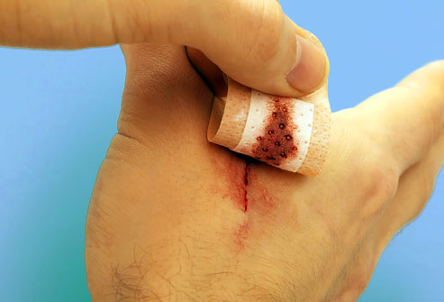
Sharp Instruments
Common Cooking Injuries
How to treat cuts:
  As soon as you cut yourself, wash the wound immediately with soap and water in order to prevent infection.
  Apply a dry, clean dressing and hold pressure directly to the wound.
  If the bleeding is very bad you should go to the emergency room immediately.
  Cuts longer than 1 cm may need stitches; visit the doctor within the first 12 hours of cutting yourself.

Slide 24
Sharp Instruments
Common Cooking Injuries
How to prevent cuts:
    Always use sharp knives. A sharp knife requires less pressure in cutting than a dull knife does, and your hand is less likely to slip.
    Cut correctly. Don’t hold something in your hand when cutting it. Use a large cutting board. Curl your fingers under when holding food and cut away from you. Keep your fingers away from the blade.
    Keep your eyes on your cutting. It’s easy to get distracted when preparing meals.

Slide 25
Requirements
Health and Safety. Do the following:
  Explain to your counselor the most likely hazards you may encounter while participating in cooking activities and what you should do to anticipate, help prevent, mitigate, and respond to these hazards
  Show that you know first aid for and how to prevent injuries or illnesses that could occur while preparing meals and eating, including burns and scalds, cuts, choking, and allergic reactions.
  Describe how meat, fish, chicken, eggs, dairy products, and fresh vegetables should be stored, transported, and properly prepared for cooking. Explain how to prevent cross-contamination.
  Discuss with your counselor food allergies, food intolerance, and food-related illnesses and diseases. Explain why someone who handles or prepares food needs to be aware of these concerns.
  Discuss with your counselor why reading food labels is important. Explain how to identify common allergens such as peanuts, tree nuts, milk, eggs, wheat, soy, and shellfish.

Slide 26
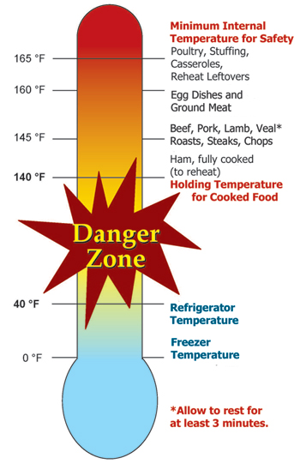
Food Safety
Meats and dairy Items must be kept cold before use.
Meat removed from wrapper must be kept separate.
Meat should be cooked before it is no longer cool.
Any cooked foods need to be properly stored and refrigerated to eliminate risks of growing bacteria.

Slide 27
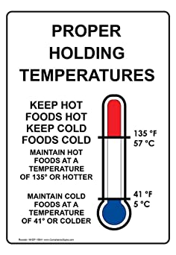
Food Safety
Keep cold foods cold.
Keep hot foods hot.
Make certain safety seals on food in jars, containers, etc. are intact.
Freeze meat or poultry that will not be used within 2-3 days.
Refrigerate any leftovers and discard if not eaten within three days or more.

Slide 28
Requirements
Health and Safety. Do the following:
  Explain to your counselor the most likely hazards you may encounter while participating in cooking activities and what you should do to anticipate, help prevent, mitigate, and respond to these hazards
  Show that you know first aid for and how to prevent injuries or illnesses that could occur while preparing meals and eating, including burns and scalds, cuts, choking, and allergic reactions.
  Describe how meat, fish, chicken, eggs, dairy products, and fresh vegetables should be stored, transported, and properly prepared for cooking. Explain how to prevent cross-contamination.
  Discuss with your counselor food allergies, food intolerance, and food-related illnesses and diseases. Explain why someone who handles or prepares food needs to be aware of these concerns.
  Discuss with your counselor why reading food labels is important. Explain how to identify common allergens such as peanuts, tree nuts, milk, eggs, wheat, soy, and shellfish.

Slide 29
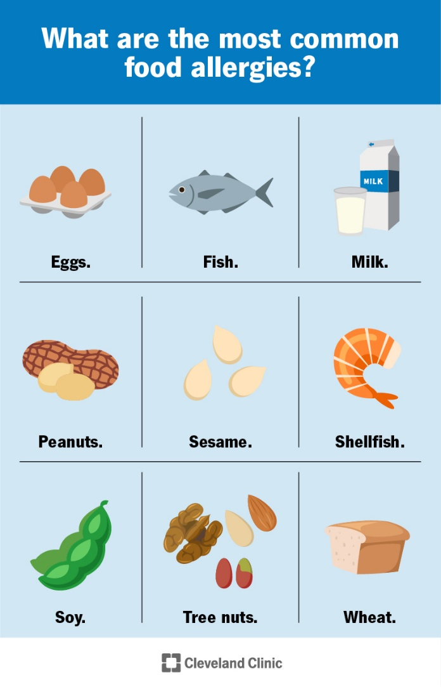
Food Allergies and Food Intolerance
Allergies:
    Immune system overreacts (Anaphylactic Shock).
    Common severe food allergies: nuts, eggs, dairy, shellfish.
Food intolerance:
    Cannot digest components.
    Common food intolerance: gluten (celiac disease), lactose.

Slide 30
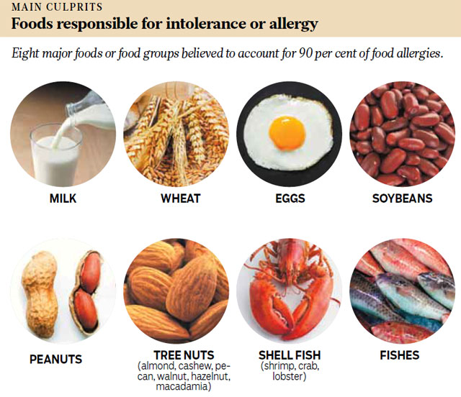

Slide 31
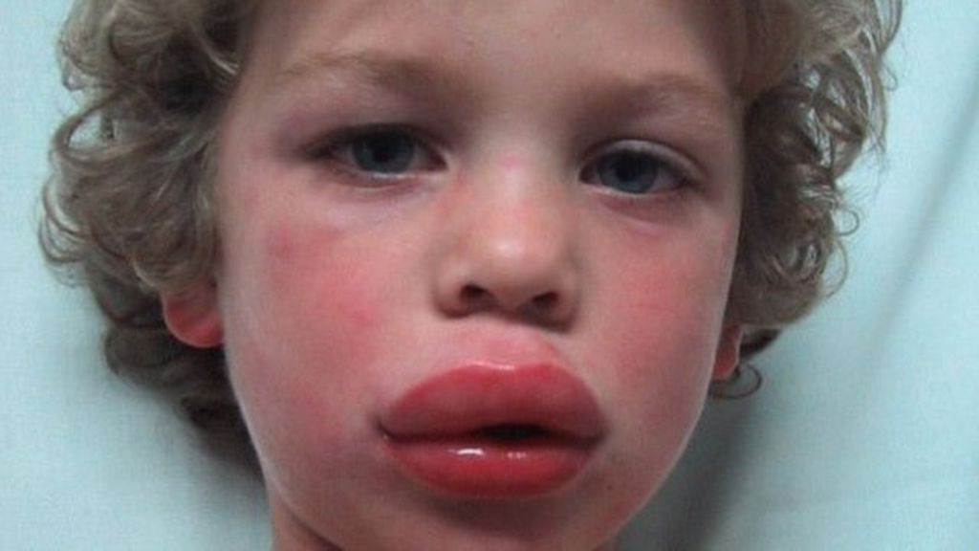
Symptoms of Allergic Reactions
Difficulty breathing, wheezing.
Tightness in throat or chest.
Swelling of the face and neck, puffy eyes.

Slide 32
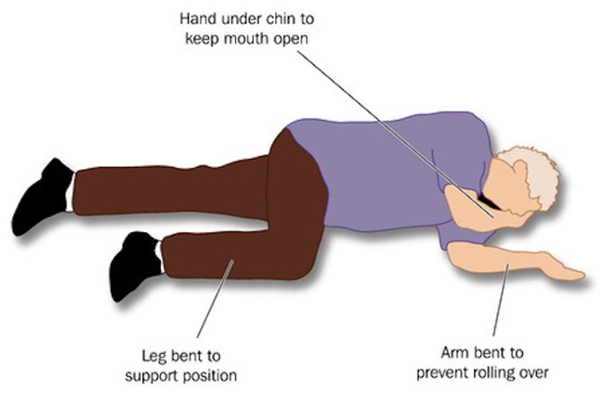
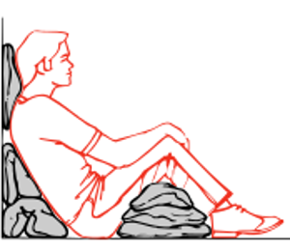
First Aid for Anaphylaxis
(Severe Allergic Reactions)
Call 911.
Lay person flat – do not allow them to stand or walk.
  If unconscious, place in recovery position.
  If breathing is difficult allow them to sit up.
Give adrenaline autoinjector (EpiPen).
Monitor the victim’s breathing and be prepared to give CPR.
Notes:
Definitely get help on the way. There is not much you can do as a first aid volunteer if their airway swells shut. You can help a victim use their EpiPen.

Slide 33
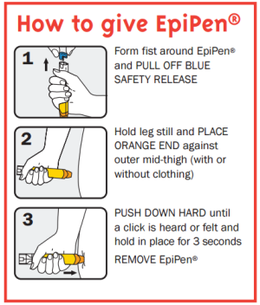

First Aid for Anaphylaxis
(Severe Allergic Reactions)
Emergency Epinephrine Kit (EpiPen)
May be carried by people with severe allergies.
Help the victim open and use the kit as needed.
Notes:
Don’t wait for symptoms to get serious. Help them take their epi shot as soon as there are difficulties.

Slide 34
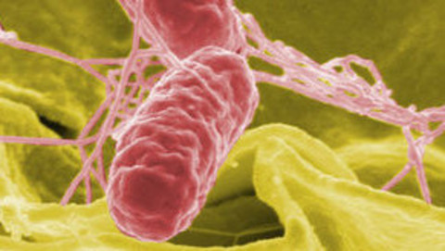
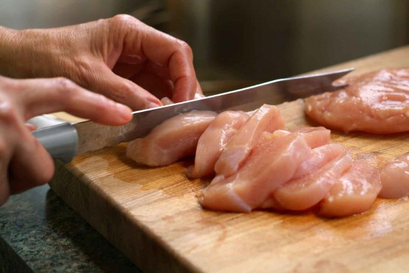
Food Sickness from Improper Handling
Salmonella Enteritis- bacteria linked to raw, uncooked eggs, poultry, unwashed raw vegetables and fruits.
Symptoms- nausea, vomiting, fever, abdominal pain, diarrhea, dehydration, weakness and loss of appetite.
Prevention- cook food through, wash all fruits and vegetables, wipe up raw meat juice from counter and sanitize, clean utensils etc.

Slide 35
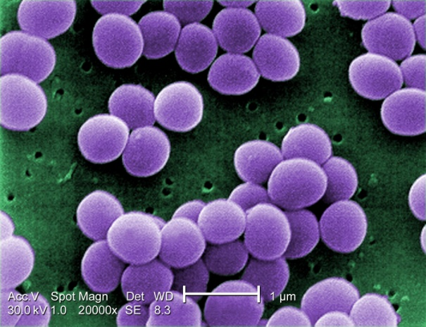
Food Sickness from Improper Handling
Staphylococcal Enteritis- bacteria multiplies in warm temperatures and thrives on protein.
Symptoms- nausea, diarrhea, headache, fever, chills, weakness and dizziness.
Prevention- wash hands and utensils before serving food, cook meat thoroughly, refrigerate leftovers promptly and in covered containers.

Slide 36
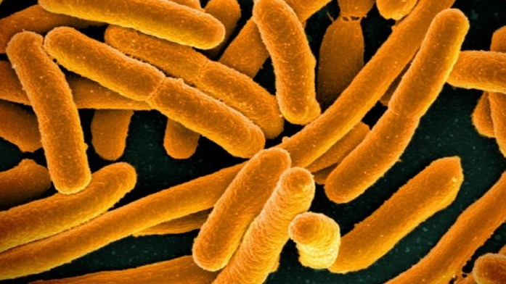
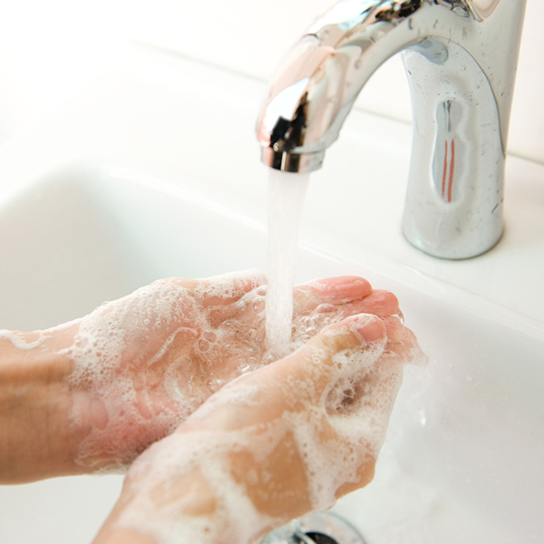
Food Sickness from Improper Handling
Escherichia Coli Enteritis (E. Coli) - bacteria that attacks the intestinal tract.
    It can be transmitted from one person to another.
    It grows at temperatures of 44 degrees and above.
    It can cause serious illness for elderly adults and young children.
Symptoms - nausea, vomiting, diarrhea, fever, and abdominal cramps.
Prevention - wash hands, foods need to be prepared in sanitary conditions, cook food through, and refrigerate foods below 44 degrees.

Slide 37
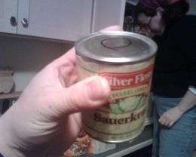
Food Sickness from Improper Handling
Botulism- this is a deadly disease. Ingestion of bacteria.
Symptoms- dry mouth, double vision, nausea, vomiting, diarrhea, abdominal cramps, sore throat, dizziness, constipation, muscle weakness, muscle paralysis, difficulty swallowing and breathing.
Prevention- never use food from bulging containers/cans, strange odor or appearance, cool leftovers quickly, and reheat all refrigerated leftover foods.

Slide 38
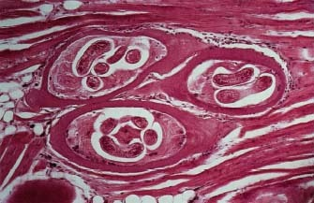
Food Sickness from Improper Handling
Trichinosis- is caused by the parasite Trichinella spiralis.
    Its larvae can remain alive in humans tissue for years.
    You get it from eating undercooked or raw meat with the parasite.
Symptoms- stomach ache, nausea, vomiting, and diarrhea.
    This occurs within one week of digesting the parasite.
    Usually from pork.
Prevention- Cook meats all the way through, especially pork.

Slide 39
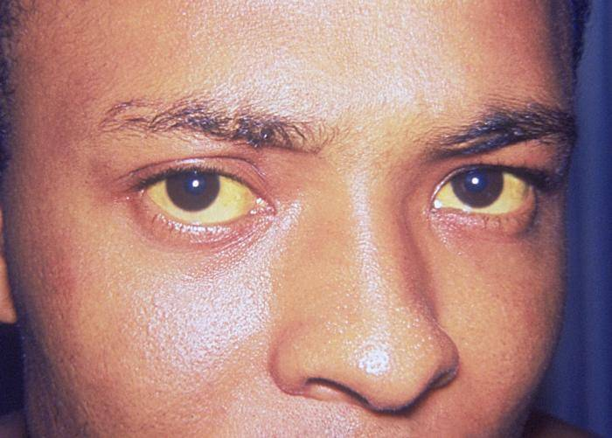
Food Sickness from Improper Handling
Hepatitis - Hepatitis A is one of five viruses that causes inflammation of the liver.
    The others are B, C, D and E.
    Hepatitis A is a mild illness characterized by sudden fever, nausea, abdominal discomfort, followed by days of jaundice.
Prevention - Wash hands with soap and warm water before preparing and eating food, scrub under fingernails, cook shellfish thoroughly, drink water from approved sources only, keep bathrooms clean and disinfected.

Slide 40
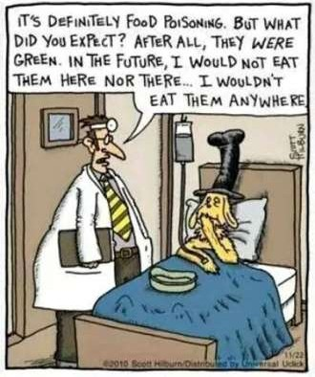
Food Safety Summary
Prevention:
  Wash hands
  Cook food
  No cross-contamination
  Immunization
  Good food management
  Know where your food comes from

Slide 41
Requirements
Health and Safety. Do the following:
  Explain to your counselor the most likely hazards you may encounter while participating in cooking activities and what you should do to anticipate, help prevent, mitigate, and respond to these hazards
  Show that you know first aid for and how to prevent injuries or illnesses that could occur while preparing meals and eating, including burns and scalds, cuts, choking, and allergic reactions.
  Describe how meat, fish, chicken, eggs, dairy products, and fresh vegetables should be stored, transported, and properly prepared for cooking. Explain how to prevent cross-contamination.
  Discuss with your counselor food allergies, food intolerance, and food-related illnesses and diseases. Explain why someone who handles or prepares food needs to be aware of these concerns.
  Discuss with your counselor why reading food labels is important. Explain how to identify common allergens such as peanuts, tree nuts, milk, eggs, wheat, soy, and shellfish.

Slide 42
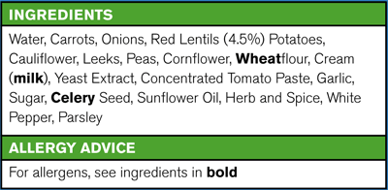
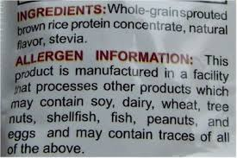
Reading a Label for Allergens
Bold text highlights allergens that are contained within the product.
Some products will inform you if it is made in a facility that processes other products that contain allergens.

Slide 43
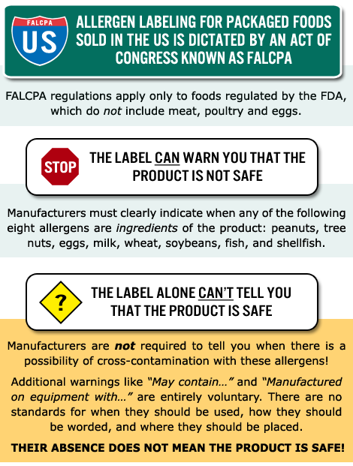
Understand the limitations of the label when concerned with food allergies.

Slide 44
Discussion
What hazards are possible?
How would you prevent these hazards?
First aid for these hazards?
How do you manage: meat, fish, eggs, dairy, fresh vegetables? Why
What can you do to prevent food-related illnesses?
What should you do about food allergies and food intolerance?

Slide 45
Nutrition

Slide 46
Requirements
Nutrition. Do the following:
  Using the MyPlate food guide or the current USDA nutrition model, give five examples for EACH of the following food groups, the recommended number of daily servings, and the recommended serving size:
    Fruits
    Vegetables
    Grains
    Proteins
    Dairy
  Explain why you should limit your intake of oils and sugars.
  Determine your daily level of activity and your caloric need based on your activity level. Then, based on the MyPlate food guide, discuss with your counselor an appropriate meal plan for yourself for one day.
  Discuss your current eating habits with your counselor and what you can do to eat healthier, based on the MyPlate food guide.
  Discuss the following food label terms: calorie, fat, saturated fat, trans fat, cholesterol, sodium, carbohydrate, dietary fiber, sugar, protein. Explain how to calculate total carbohydrates and nutritional values for two servings, based on the serving size specified on the label.

Slide 47
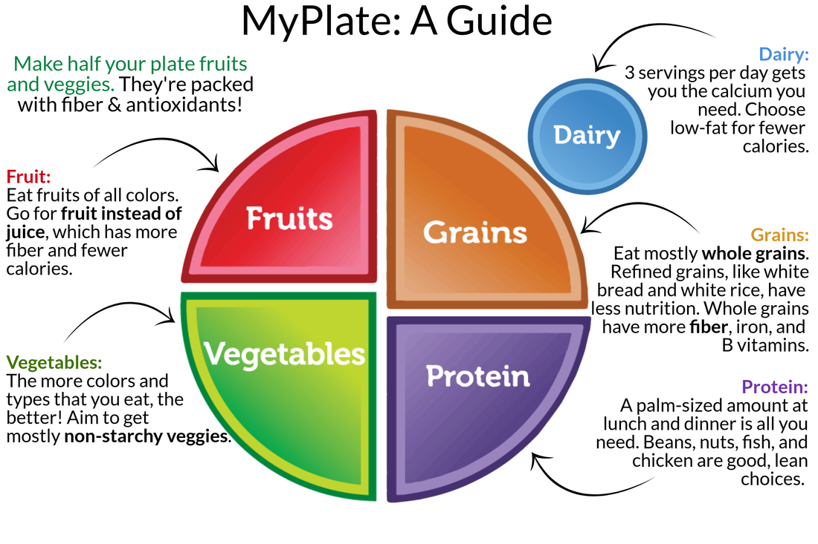

Slide 48
Recommended Number of Servings
Food group | 1,600-calorie diet | 2,000-calorie diet
Grains (mainly whole grains) | 6 a day | 6-8 a day
Vegetables | 3-4 a day | 4-5 a day
Fruits | 4 a day | 4-5 a day
Low-fat or fat-free milk and milk products | 2-3 a day | 2-3 a day
Lean meats, poultry and fish | 3-4 one-ounce servings or fewer a day | 6 one-ounce servings or fewer a day
Nuts, seeds and legumes | 3-4 a week | 4-5 a week
Fats and oils | 2 a day | 2-3 a day
Sweets and added sugars | 3 or fewer a week | 5 or fewer a week

Slide 49
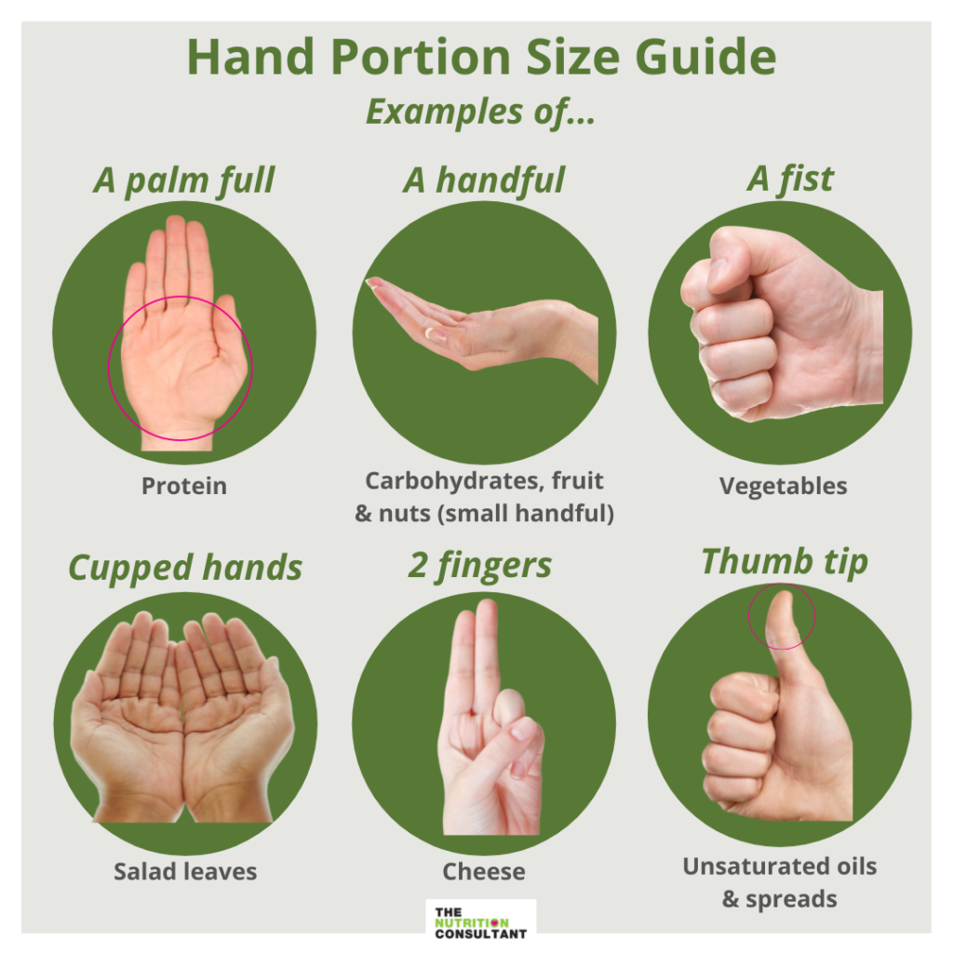

Slide 50
Examples of Single Servings for Each Food Group
Grains
  1 slice whole-wheat bread
  1 ounce dry whole-grain cereal
  1/2 cup cooked cereal, rice or pasta (preferably whole grain)
Vegetables
  1 cup raw leafy green vegetable
  1/2 cup cut-up raw or cooked vegetables
  1/2 cup (4 fluid ounces) low-sodium vegetable juice
Fruits
  1 medium fruit
  1/4 cup dried fruit
  1/2 cup fresh, frozen or canned fruit
  1/2 cup (4 fluid ounces) 100% fruit juice

Slide 51
Examples of Single Servings for Each Food Group
Milk and milk products
  1 cup (8 fluid ounces) low-fat or fat-free milk
  1 cup low-fat or fat-free yogurt
  1 1/2 ounces low-fat or fat-free cheese
Meat, poultry and fish
  1 ounce cooked lean meat, skinless poultry or fish
  1 egg
  2 egg whites
Nuts, seeds and legumes
  1/3 cup (1 1/2 ounces) nuts
  2 tablespoons peanut butter
  2 tablespoons (1/2 ounce) seeds
  1/2 cup cooked legumes (dried beans or peas)

Slide 52
Examples of Single Servings for Each Food Group
Fats and oils
  1 teaspoon soft margarine
  1 teaspoon vegetable oil
  1 tablespoon mayonnaise
  2 tablespoons low-fat salad dressing (or 1 tablespoon regular dressing)
Sweets and added sugars
  1 tablespoon sugar
  1 tablespoon jelly or jam
  1/2 cup sorbet
  1 cup (8 fluid ounces) sugar-sweetened lemonade

Slide 53

Get To Know Your Food Groups
Created by U.S. Dept. of Agriculture
Types of foods people should eat as well as quantity for a healthy life.
Emphasizes fruits; vegetables, whole grains, low fat dairy products, lean meats, poultry, fish, beans, eggs and nuts.

Slide 54
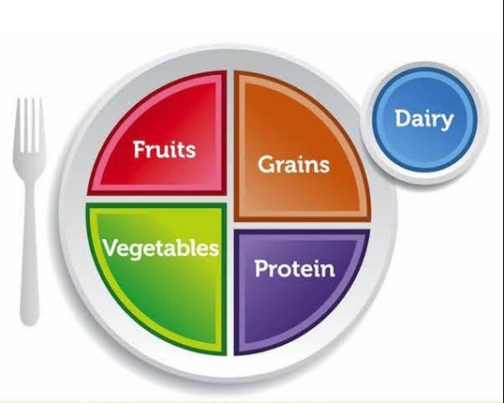
Fruits
Focus on fruits
  Fruits can be fresh, frozen, canned or dried.
  Great substitutes for sugary sweets.
  Berries: blueberries, raspberries, strawberries.
  Citrus: oranges, grapefruit, tangerines, pineapple.
  Melons: cantaloupe, honeydew
  Pitted: apricots, avocado, cherries, mangoes, prune
  Others: apples, banana, grapes, kiwi fruit, pears.

Slide 55
Vegetables
Vary your veggies
  Fresh is best, then frozen and canned last.
  Greens: broccoli, collard greens, turnip, leafy lettuce.
  Orange: acorn squash, butternut squash, pumpkin.
  Dried Beans/Peas: black eyed peas, garbanzo, lentils, navy bean, soybeans etc.
  Starchy: sweet corn, green peas, lima beans, potatoes
  Other Vegetables: artichokes, asparagus, beets, brussel sprouts, cabbage, cauliflower, celery, cucumbers, eggplant, green beans, green or red peppers, okra and radish.

Slide 56
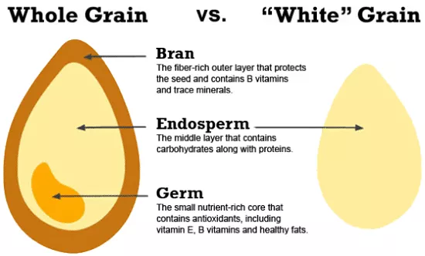
Grains
Two subgroups in Grain
  Whole Grains are complex carbohydrates. Provide energy and stamina for the body.
    Examples are whole wheat bread, oatmeal, brown rice.
    Good source of fiber, iron and many B vitamins.
    These grains take the body longer to process. Good hiking food.

Slide 57
Grains
Two subgroups in Grain
  Refined Grains are milled and processed.
  All of the bran, many vitamins and nutrients are removed.
  They are enriched with vitamins, but not the bran.
  Examples are noodles, rice, pasta, macaroni, white flour.

Slide 58
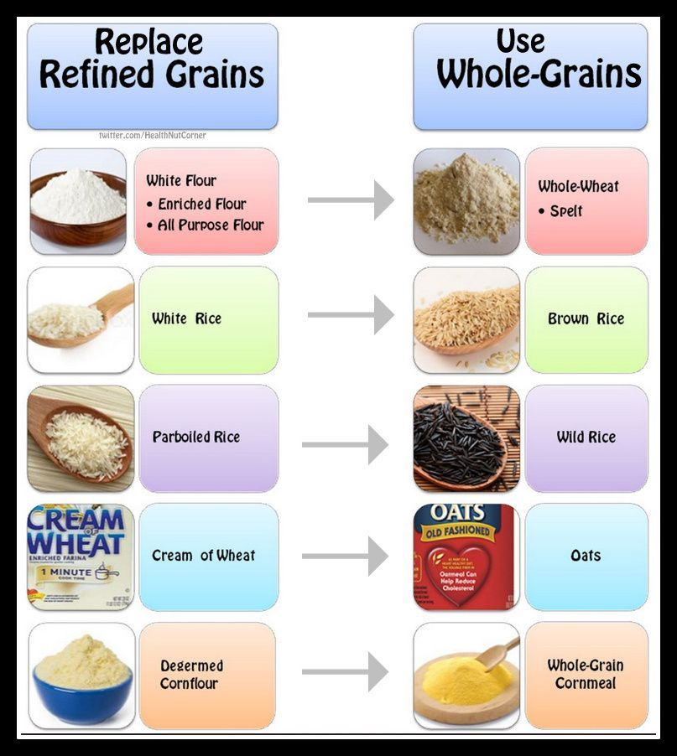

Slide 59
Protein Foods
Seafood: salmon, tuna, trout, tilapia, sardines, herring, mackerel, shrimp, crab, oysters, mussels, etc.
Meat, Poultry, and Eggs: beef, chicken, turkey, pork, eggs, etc.
Nuts, Seeds, and Soy: nuts, nut butters, seeds, soy products, etc.
These products supply most of your protein to keep bones and muscles strong.
  It also provides energy.
Utilize lean cuts of meat and poultry.
Some meats that are not lean are extremely fattening like bacon, sausage, hotdogs, processed meats.
  These should be used sparingly.

Slide 60
Dairy
Calcium rich foods
In this group all products are made of milk.
  Yogurt, cheese, cottage cheese, puddings, ice cream, and cream soups.
Use low fat or skim as much as possible, regular milk is very high in calories and fat.
Yogurts, sweetened drink/chocolate, strawberry milk high in sugar.
  Limit to skim to reduce calories.

Slide 61
Requirements
Nutrition. Do the following:
  Using the MyPlate food guide or the current USDA nutrition model, give five examples for EACH of the following food groups, the recommended number of daily servings, and the recommended serving size:
    Fruits
    Vegetables
    Grains
    Proteins
    Dairy
  Explain why you should limit your intake of oils and sugars.
  Determine your daily level of activity and your caloric need based on your activity level. Then, based on the MyPlate food guide, discuss with your counselor an appropriate meal plan for yourself for one day.
  Discuss your current eating habits with your counselor and what you can do to eat healthier, based on the MyPlate food guide.
  Discuss the following food label terms: calorie, fat, saturated fat, trans fat, cholesterol, sodium, carbohydrate, dietary fiber, sugar, protein. Explain how to calculate total carbohydrates and nutritional values for two servings, based on the serving size specified on the label.

Slide 62
Fats, Oils, and Sweets
Fats, oils, and sweets give us calories.
Most of these foods do not contain many vitamins or minerals so they are called "empty calorie" foods.
When we eat them along with foods like grains, fruits, vegetables, milk and meat products they are part of a healthy diet.
Eating too many fats, oils or sweets can be a problem when we eat them instead of foods and nutrients we get in the other food groups.

Slide 63
Requirements
Nutrition. Do the following:
  Using the MyPlate food guide or the current USDA nutrition model, give five examples for EACH of the following food groups, the recommended number of daily servings, and the recommended serving size:
    Fruits
    Vegetables
    Grains
    Proteins
    Dairy
  Explain why you should limit your intake of oils and sugars.
  Determine your daily level of activity and your caloric need based on your activity level. Then, based on the MyPlate food guide, discuss with your counselor an appropriate meal plan for yourself for one day.
  Discuss your current eating habits with your counselor and what you can do to eat healthier, based on the MyPlate food guide.
  Discuss the following food label terms: calorie, fat, saturated fat, trans fat, cholesterol, sodium, carbohydrate, dietary fiber, sugar, protein. Explain how to calculate total carbohydrates and nutritional values for two servings, based on the serving size specified on the label.

Slide 64
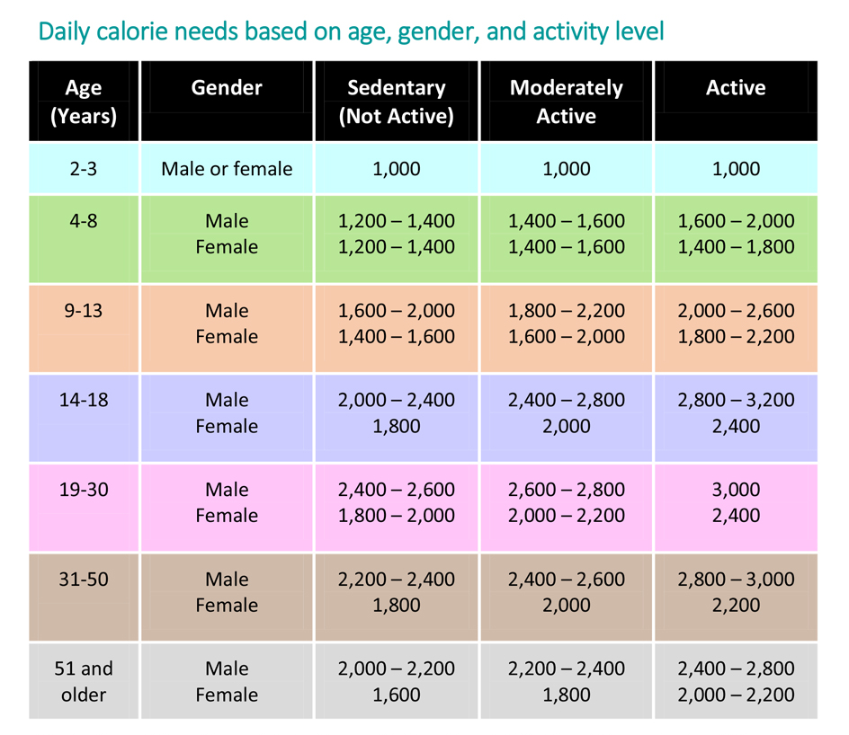
How many calories do I need?

Slide 65
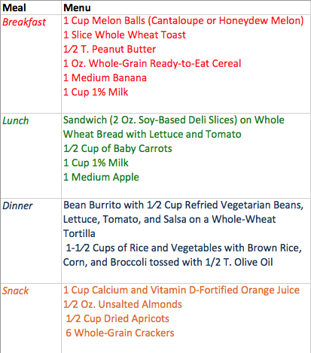
Sample Vegetarian One-Day Meal Plan

Slide 66
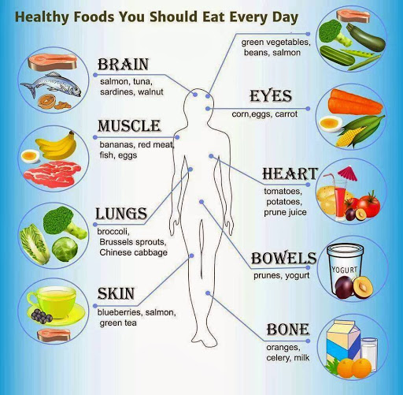

Slide 67
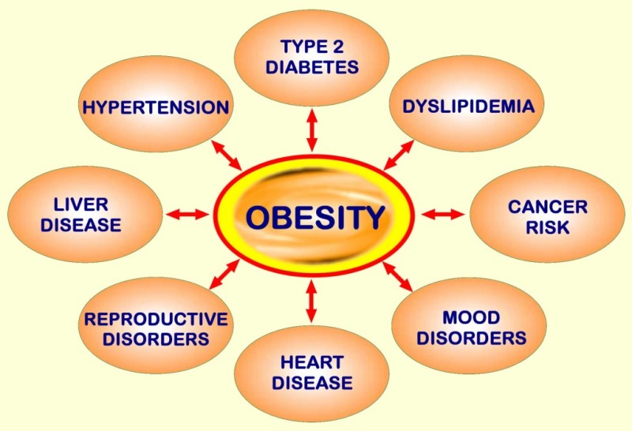
What happens if I get…?
too many calories
    from carbs and fat.
      Will store as fat (~3500 cal/lb)
    from proteins.
      Gout
Key long-term problems.
      Obesity
      Diabetes
      Liver failure

Slide 68
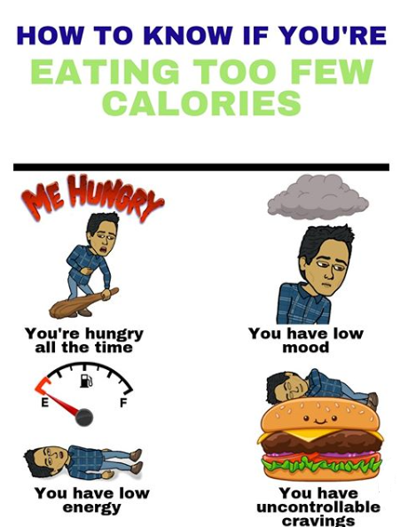
What happens if I get …?
too few calories.
    Body takes energy out of storage.
    Long-term health problems.
      Heart rhythm abnormalities
      Depression
      Anemia
      Brittle bones
    Feast-or-famine syndrome.
      Eating too few calories can actually sabotage weight-loss efforts.
    Body functions begin to shutdown.

Slide 69
Discussion
Describe what you’ve eaten today or yesterday. Does it follow the MyPlate guidelines?
Is your caloric intake a good fit for your activity level?
Describe the long-term consequences of your current eating habits.
Describe a balanced meal plan for a day.
How can you improve your diet? Do you want to? Why?

Slide 70
Requirements
Nutrition. Do the following:
  Using the MyPlate food guide or the current USDA nutrition model, give five examples for EACH of the following food groups, the recommended number of daily servings, and the recommended serving size:
    Fruits
    Vegetables
    Grains
    Proteins
    Dairy
  Explain why you should limit your intake of oils and sugars.
  Determine your daily level of activity and your caloric need based on your activity level. Then, based on the MyPlate food guide, discuss with your counselor an appropriate meal plan for yourself for one day.
  Discuss your current eating habits with your counselor and what you can do to eat healthier, based on the MyPlate food guide.
  Discuss the following food label terms: calorie, fat, saturated fat, trans fat, cholesterol, sodium, carbohydrate, dietary fiber, sugar, protein. Explain how to calculate total carbohydrates and nutritional values for two servings, based on the serving size specified on the label.

Slide 71
Calorie - is a unit of energy. In nutrition, calories refer to the energy people get from the food and drink they consume, and the energy they use in physical activity. Calories are listed in the nutritional information on all food packaging. Many weight loss programs center around reducing the intake of calories.
Fat - serve both as energy sources for the body, and as stores for energy in excess of what the body needs immediately. Each gram of fat when burned or metabolized releases about 9 food calories.
Saturated fat - is a type of dietary fat. It is one of the unhealthy fats. These fats are most often solid at room temperature. Foods like butter, palm and coconut oils, cheese, and red meat have high amounts of saturated fat.
Trans fats – are a form of unsaturated fat. Artificial trans fats (or trans fatty acids) are created in process that adds hydrogen to liquid vegetable oils to make them more solid (margarine and Crisco). Trans fats raise your bad (LDL) cholesterol levels and lower your good (HDL) cholesterol levels. Eating trans fats increases your risk of developing heart disease and stroke. It’s also associated with a higher risk of developing type 2 diabetes.

Slide 72
Cholesterol - is a waxy, fat-like substance that's found in all the cells in your body. Your body needs some cholesterol to make hormones, vitamin D, and substances that help you digest foods. Your body makes all the cholesterol it needs. Cholesterol is also found in foods from animal sources, such as egg yolks, meat, and cheese. If you have too much cholesterol in your blood, it can combine with other substances in the blood to form plaque. Plaque sticks to the walls of your arteries. This buildup of plaque is known as atherosclerosis. It can lead to coronary artery disease, where your coronary arteries become narrow or even blocked.
Sodium - is an essential mineral that regulates blood volume, blood pressure, osmotic equilibrium and pH. Too much sodium in the diet can lead to high blood pressure, heart disease, and stroke.

Slide 73
Carbohydrates - are the sugars, starches and fibers found in fruits, grains, vegetables and milk products. They are one of the basic food groups and are important to a healthy diet. Excess carbs can lead to weight gain. Carbs commonly considered bad include pastries, sodas, and highly processed foods. Bad carbs rarely have nutritional value. Good carbs are complex carbs, such as whole grains, fruits, vegetables, beans and legumes. They are processed more slowly and also contain a many of other nutrients.
Dietary fiber - also known as roughage, is the indigestible part of plant foods. Fiber has a host of health benefits, including reducing the risk of heart disease and type 2 diabetes. Fiber is mostly in vegetables, fruits, whole grains, and legumes.
Sugar - is the generic name for sweet-tasting, soluble carbs, many of which are used in food. Table sugar refers to sucrose. Sugar is a source of carbohydrate and energy. On its own, sugar has no other nutrients.
Proteins - are essential nutrients for the human body. They are one of the building blocks of body tissue and can also serve as a fuel source. As a fuel, proteins provide as much energy density as carbohydrates:

Slide 74
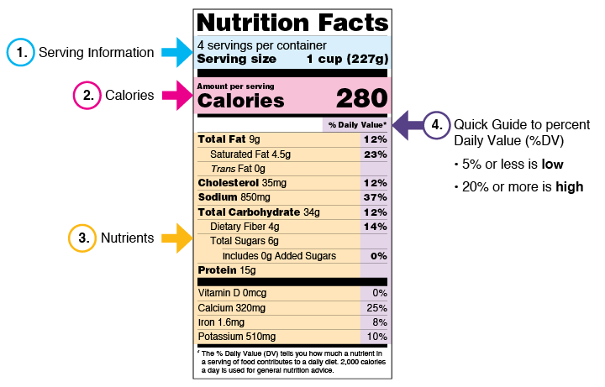
How to Read a Food Label

Slide 75

How to Read a Food Label
Serving Information
  Serving sizes are standardized to make it easier to compare similar foods; they are provided in familiar units, such as cups or pieces, followed by the metric amount, e.g., the number of grams (g). The serving size reflects the amount that people typically eat or drink. It is not a recommendation of how much you should eat or drink.

Slide 76
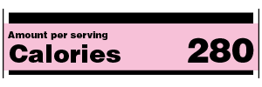
How to Read a Food Label
Calories
  Calories provide a measure of how much energy you get from a serving of this food. To achieve or maintain a healthy body weight, balance the number of calories you eat and drink with the number of calories your body uses. 2,000 calories a day is used as a general guide for nutrition advice. Your calorie needs may be higher or lower and vary depending on your age, sex, height, weight, and physical activity level. Remember: The number of servings you consume determines the number of calories you actually eat. Eating too many calories per day is linked to overweight and obesity.

Slide 77
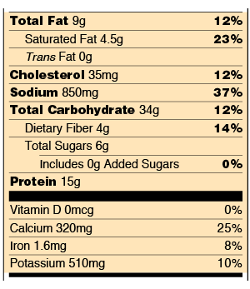
How to Read a Food Label
Nutrients
  It shows you some key nutrients that impact your health. You can use the label to support your personal dietary needs – look for foods that contain more of the nutrients you want to get more of and less of the nutrients you may want to limit.

Slide 78
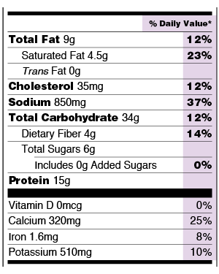
How to Read a Food Label
The Percent Daily Value (%DV)
  The % Daily Value (%DV) is the percentage of the Daily Value for each nutrient in a serving of the food. The Daily Values are reference amounts (expressed in grams, milligrams, or micrograms) of nutrients to consume or not to exceed each day.

Slide 79
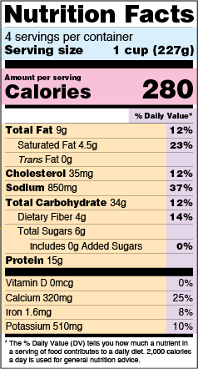
How to Read a Food Label
It’s important to realize that all the nutrient amounts shown on the label, including the number of calories, refer to the size of the serving.
Pay attention to the serving size, especially how many servings there are in the food package.
In the sample label, one serving equals 1 cup. If you ate two cups, you would be consuming two servings. That is two times the calories and nutrients shown in the sample label, so you would need to double the nutrient and calorie amounts, as well as the %DVs, to see what you are getting in two servings.

Slide 80
Requirements
Cooking Basics. Do the following:
  Discuss the following cooking methods. For each one, describe the equipment needed, how temperature control is maintained, and name at least one food that can be cooked using that method: baking, boiling, broiling, pan frying, simmering, microwaving, air frying, grilling, foil cooking, Dutch oven.
  Discuss the benefits of using a camp stove on an outing vs. a charcoal or wood fire.
  Describe with your counselor how to manage your time when preparing a meal so components for each course are ready to serve at the same time.
  Explain and give examples of how taste, texture, and smell impact what we eat.

Slide 81
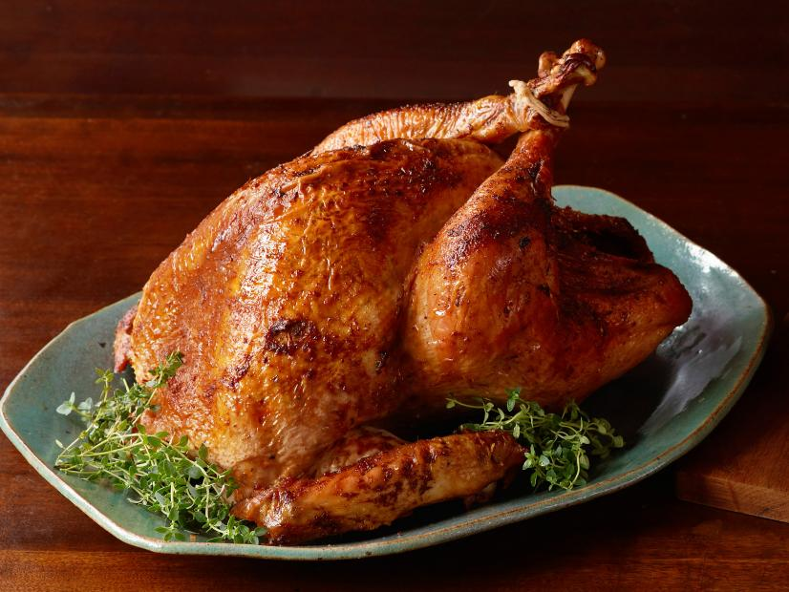

Baking
Baking is a method of preparing food that uses dry heat, normally in an oven. The most common baked item is bread but many other types of foods are baked. Heat is gradually transferred "from the surface of cakes, cookies, and breads to their center.

Slide 82
How to Bake
Select the item you wish to bake and prepare according to directions.
If the dish you are baking requires the oven to be preheated, turn the oven on at this time and select the proper temperature per your recipe.
To ensure even baking, unless otherwise specified in your recipe, select the rack in the center of your oven for best results.
Set a timer for the recipe's recommended time after your dish is placed in the oven.
Do a visual check on your recipe about three quarters of the way through the cooking process, to make sure it is cooking evenly and not cooking too fast.
When the timer sounds or when you think your recipe is cooked, gently open the oven door all the way. To prevent burns, use an oven mitt or pot holders to slide out the rack.

Slide 83
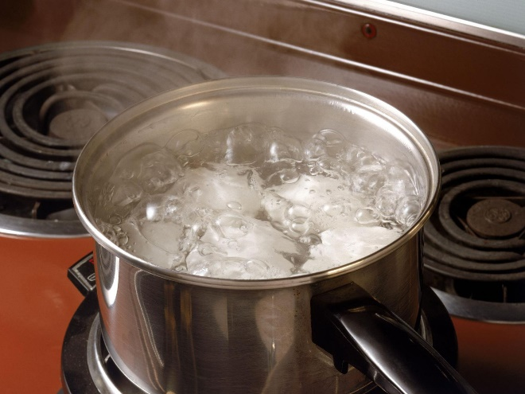
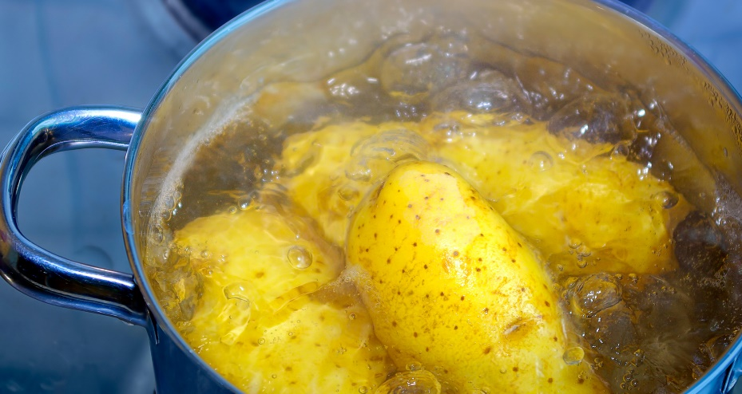
Boiling
In the kitchen, boiling is cooking food at a relatively high temperature, 212 degrees, in water or some other water-based liquid. It's a vigorous process that works best for sturdier foods; anything delicate can get damaged. Eggs, pasta, and potatoes are often boiled.

Slide 84
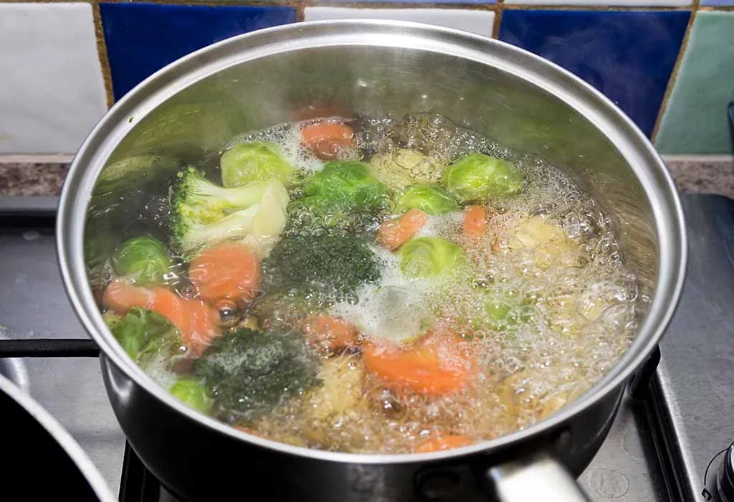
How to Boil Food
Requires little more than a heavy-bottomed pot or saucepan to evenly distribute the heat and a stove.
Boiling is used primarily to cook meats, pasta, and vegetables.
When boiling vegetables or pasta, add the uncooked food to water that's fully churning.
Meat and root vegetables should be boiled by placing them in a pot of cold water first, and then slowly bring them to a boil.

Slide 85
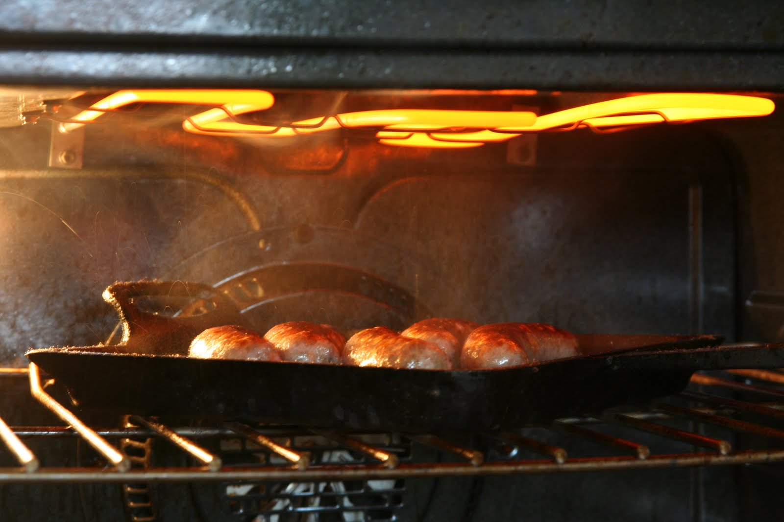
Broiling
Broiling is a high-heat cooking method where food is cooked directly under or over intense heat, usually from an oven broiler or grill.
It's great for cooking meats, fish, and vegetables quickly while creating a nice caramelized crust.

Slide 86
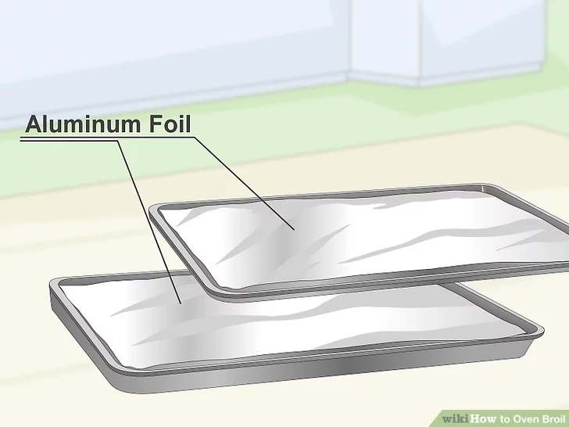
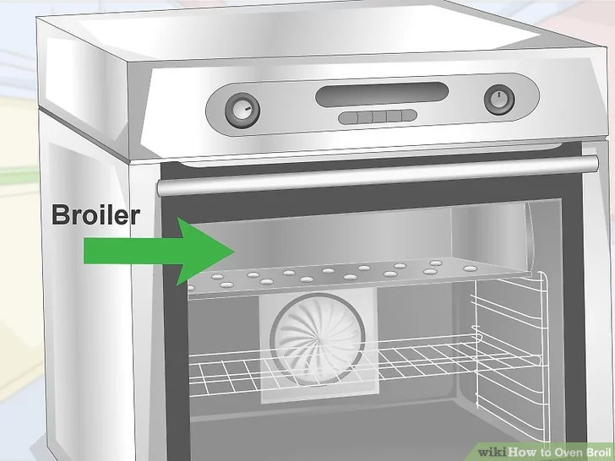
How to Broil
Prepare Your Equipment
  Oven broiler: Turn on the broiler setting (usually around 500°F–550°F).
  Broiler pan or baking sheet: Use a broiler-safe pan or a cast iron skillet. If using a baking sheet, line it with aluminum foil for easier cleanup.
  Oven rack position: Place the rack 4–6 inches from the broiler (closer for thin foods, further for thick foods).

Slide 87
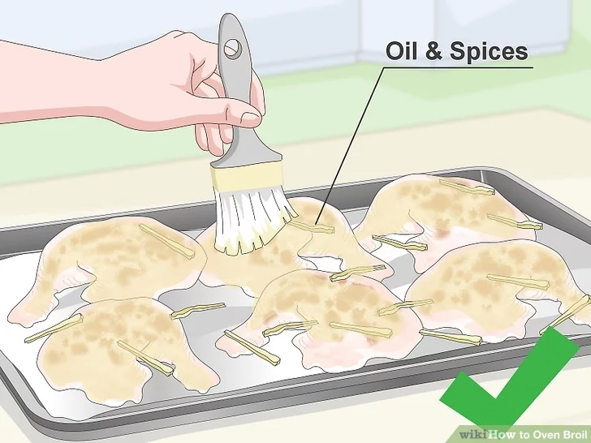
How to Broil
Choose and Prepare Your Food
  Meats (steak, chicken, fish, pork chops): Pat dry, season well, and brush with oil to prevent sticking.
  Vegetables (peppers, asparagus, mushrooms): Toss in oil and season before broiling.
  Cheese dishes (melted cheese toppings on casseroles or sandwiches): Keep a close eye to prevent burning.

Slide 88
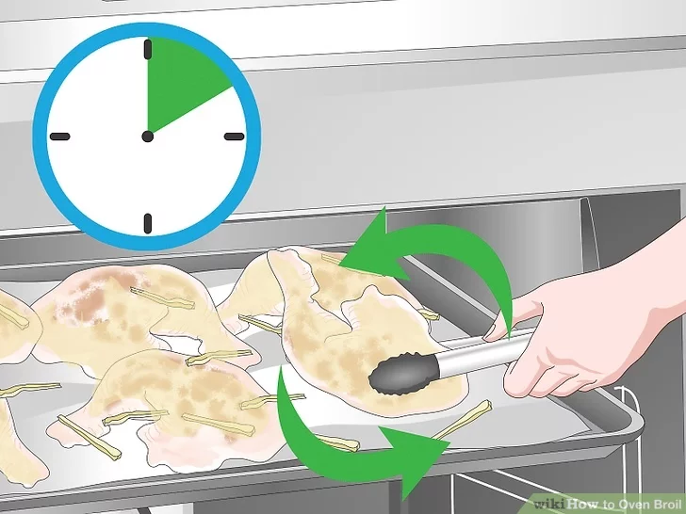
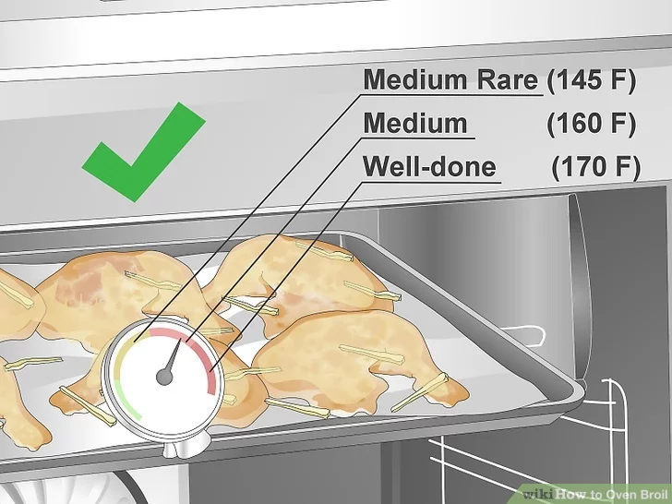
How to Broil
Broil Your Food
  Place food on the broiler pan to allow fat to drip off.
  Set a timer (broiling is fast—5 to 15 minutes depending on thickness).
  Flip halfway through (for meats and some vegetables) for even cooking.
  Watch closely—food can burn quickly under high heat!
Check for Doneness
  Use a meat thermometer to ensure proper internal temperature:
    Chicken: 165°F
    Steak (medium-rare): 130–135°F
    Fish: 145°F
  Broiled food should have a crispy, browned surface.

Slide 89



Pan Frying
A form of frying characterized by the use of minimal cooking oil; typically using just enough oil to lubricate the pan. Because of the partial coverage, the food must be flipped at least once to cook both sides.
Use a heavy-bottomed pan for evenly distributed heat with no hot spots. Nonstick skillets allow you to use less oil than traditional pan-fried recipes.
Start many foods on medium-high heat to initiate browning, then reduce the heat to allow it to finish cooking more slowly.
Fish fillets, pork chops, hamburgers, chicken, and sturdy vegetables such as potatoes are often pan fried

Slide 90


Simmering
Simmering is a food preparation technique by which foods are cooked in hot liquids kept just below the boiling point of water (lower than 100 °C or 212 °F)
To keep a pot simmering, one brings it to a boil and then reduces the heat to a point where the formation of bubbles has almost ceased.

Slide 91

Microwaving
Microwaves cause water molecules in food to vibrate, producing heat that cooks the food. Foods high in water content, like fresh vegetables, can be cooked more quickly than other foods.
Microwave cooking can be more energy efficient because foods cook faster and the energy heats only the food, not the whole oven compartment.
Foods cooked in a microwave oven may keep more of their vitamins and minerals, because microwave ovens can cook more quickly and without adding water.

Slide 92


Do’s and Don’ts of Microwaving
DO follow the instructions of your microwave.
Don't use metal bowls or utensils.
Do use glass, ceramic or microwave safe plastic containers.
Don't cook all foods for the same time.
Do stir food occasionally.
Do heat it until bubbling and/or steaming.
Don't microwave food uncovered.
Do clean it often.
Do check on your food frequently.

Slide 93

Air Frying
Air frying is a healthier cooking method that mimics deep frying by using hot air circulation to create a crispy texture with minimal oil.
It's great for meats, vegetables, frozen foods, and even baked goods!

Slide 94



How to Air Fry
Prepare Your Air Fryer
  Preheat the air fryer (if required)—usually 3–5 minutes at 350°F–400°F.
  Use the right basket/tray—make sure it’s clean and dry.
Prepare Your Food
  Pat food dry if necessary (moisture can prevent crisping).
  Lightly coat with oil (optional, but helps with browning).
  Season with salt, pepper, or your favorite spices.
Arrange Food in the Basket
  Place food in a single layer—don’t overcrowd! (Air needs to circulate for even cooking).
  If cooking in batches, shake the basket between batches to redistribute heat.

Slide 95


How to Air Fry
Select the Right Temperature & Time
  Here are common air fryer settings:
    Fries/Potatoes: 375°F, 15–20 minutes
    Chicken (Wings, Drumsticks, Tenders): 375°F–400°F, 15–25 minutes
    Fish & Seafood: 350°F–375°F, 10–15 minutes
    Vegetables: 375°F, 8–12 minutes
    Frozen Foods (Nuggets, Fries, Mozzarella Sticks): 375°F, 10–15 minutes
    Baked Goods (Cookies, Muffins): 320°F–350°F, 10–15 minutes
Shake or Flip Halfway
  Halfway through cooking, shake the basket or flip food for even crispiness.

Slide 96

How to Air Fry
Check for Doneness
  Use a food thermometer for meats:
    Chicken: 165°F
    Steak (medium-rare): 130–135°F
    Fish: 145°F
  Food should be golden and crispy on the outside.

Slide 97

Grilling
Grilling is a form of cooking that involves dry heat applied to the surface of food, commonly from above, below or from the side. Grilling usually involves a significant amount of direct, radiant heat, and tends to be used for cooking meat and vegetables quickly.
Steak, hamburgers, chicken, and hot dogs are the most popular foods to grill.
In general all beef products should be cooked over direct heat and with the grill on the high setting.

Slide 98
How to Grill
Pre-heat your grill before you start cooking.
After your grill is preheated, use a brass-wire brush to scrape the charred goo and gunk off of the grate.
Once your grill is clean, oil the grate by grabbing an oiled paper towel with some long tongs, and wiping it over the bars.
  You’ll need to use an oil with a high smoking temperature, like canola oil.
Now that your grill is hot and the grate is clean, your food won’t stick to it as much, and you’re likely to get those classic grill lines!
To avoid losing juices during turning, always flip your meat or vegetables using tongs or a spatula, rather than a fork.
Limit the flips. Ideally, you should flip each item once during the grilling process.
Whatever you do, don’t press down on burgers or chicken (or anything) with a spatula while they’re grilling! This squeezes out the juices and once they’re gone … they’re gone!

Slide 99

Foil Cooking
Foil cooking is a simple and fun outdoor cooking method often used in camping or backyard meals.
You wrap food in aluminum foil and cook it over a campfire, grill, or even in an oven.
It’s great for meats, veggies, and complete meals with minimal cleanup!
What You’ll Need:
  Heavy-duty aluminum foil (regular foil can tear)
  Tongs or fire gloves
  Heat source: Campfire, grill, or oven
  Cooking spray or oil (to prevent sticking)

Slide 100
Steps to Make a Foil Packet (Hobo Packets)
Tear Off a Foil Sheet
  Use a piece that’s about 18–24 inches long depending on your meal size.
  Double-layer for extra protection if cooking over an open fire.
Add Oil or Cooking Spray
  Lightly spray or rub the center of the foil to avoid food sticking.
Layer Your Ingredients
  Put hearty items (like potatoes or carrots) on the bottom.
  Place meats (like chicken, beef, or fish) in the center.
  Add quick-cooking veggies (like bell peppers, onions, or zucchini) on top.
Season It Up
  Add salt, pepper, spices, herbs, or sauces for flavor.
Seal the Foil Packet
  Bring the long sides together and fold down tightly.
  Fold up the short ends to create a sealed packet (like a burrito).
  Make sure it’s tightly sealed so steam stays in while cooking.

Slide 101


Slide 102
Foil Cooking Methods and Times
Over a Campfire or Grill
  Place packet on hot coals or grill grate, not in flames.
  Cook time: 15–30 minutes, depending on ingredients.
  Flip halfway through using tongs.
In the Oven
  Preheat to 375°F–400°F
  Place packets on a baking sheet
  Bake for 20–30 minutes

Slide 103


Slide 104


Dutch Oven Cooking
A Dutch oven is a thick-walled cooking pot with a tight-fitting lid. Dutch ovens are usually made of seasoned cast iron; however, some Dutch ovens are instead made of cast aluminum.
A camping Dutch oven usually has three integral legs, a wire bail handle, and a slightly concave, rimmed lid so that coals from the cooking fire can be placed on top as well as below.
Dutch ovens are well suited for long, slow cooking, such as in making roasts, stews, and casseroles. Almost any recipe that can be cooked in a conventional oven can be cooked in a Dutch oven.

Slide 105


Dutch Oven Cooking
It is also possible to stack Dutch ovens on top of each other, conserving the heat that would normally rise from the hot coals on the top.
After use Dutch ovens are typically cleaned like other cast-iron cookware: with boiling water, and a soft brush or sponge, then dried and lightly oiled.

Slide 106


Dutch Oven Cooking Tips
Always keep an eye on your ovens.
Wait for your fire to have hot coals rather than yellow flames.
Season your Dutch oven with oil before cooking to help minimize food sticking.
If steam is forcing its way out around the lid, the oven is too hot.
Use a pie tin set on 4 pebbles in the Dutch oven for rolls, biscuits, or pies to prevent burning.

Slide 107


Dutch Oven Cooking Tips
Always clean and dry your Dutch oven after use. Letting it sit wet or in water or rain will rust it.
Make sure you have food or water in your Dutch oven before placing it on coals, unless you are monitoring the heating. An empty oven can burn off the seasoning easily.
Use wooden or high-temperature silicone utensils. Plastic spatulas touching the Dutch oven sides can melt, and metal can scratch.
A common mistake is to set the lid on the ground. Make sure you have a clean, sturdy place to set the lid.
Use a Dutch oven liner to help with clean-up of sugary desserts.

Slide 108
Requirements
Cooking Basics. Do the following:
  Discuss EACH of the following cooking methods. For each one, describe the equipment needed, how temperature control is maintained, and name at least one food that can be cooked using that method: baking, boiling, broiling, pan frying, simmering, steaming, microwaving, grilling, foil cooking, and use of a Dutch oven.
  Discuss the benefits of using a camp stove on an outing vs. a charcoal or wood fire.
  Describe with your counselor how to manage your time when preparing a meal so components for each course are ready to serve at the same time.
  Explain and give examples of how taste, texture, and smell impact what we eat.

Slide 109


Camp Stoves Vs. Campfires
Stoves
Advantages:
  Quick to set up. It's just like cooking on the stove at home. Much better control of heat. Using a portable stove that accommodates large pots or skillets makes sense for larger groups. When cooking for one, a small camp stove is faster and easier than making a campfire. With gusty winds, a stove with a protective shield can keep you on schedule for mealtimes. You can use a stove in areas where campfires are prohibited. Stoves have almost no environmental impact
Disadvantages:
  More equipment is required.

Slide 110

Camp Stoves Vs. Campfires
Campfires
Advantages:
  With a little know-how, you can start a fire nearly anywhere. Less equipment to bring.
Disadvantages:
  Slower to set up. Can darken pots. Harder to control and regulate heat. More prone to burning food/hands. Some locations ban visitors from collecting firewood from the local forest. Conversely, some locations do not allow outside firewood due to pest concerns. Campfires may be banned in areas of forest fire danger. If has been raining, it's going to be difficult to find wood that is dry enough to burn properly. Campfires make “leave-no-trace” camping virtually impossible.

Slide 111
Requirements
Cooking Basics. Do the following:
  Discuss EACH of the following cooking methods. For each one, describe the equipment needed, how temperature control is maintained, and name at least one food that can be cooked using that method: baking, boiling, broiling, pan frying, simmering, steaming, microwaving, grilling, foil cooking, and use of a Dutch oven.
  Discuss the benefits of using a camp stove on an outing vs. a charcoal or wood fire.
  Describe with your counselor how to manage your time when preparing a meal so components for each course are ready to serve at the same time.
  Explain and give examples of how taste, texture, and smell impact what we eat.

Slide 112
Time Management
Before you start to cook, go through the recipe’s list of ingredients, make sure you have everything you need, and then prepare everything you need.
  Chop produce, peel garlic, measure out spices and seasonings, etc.
  Prepare each ingredient and place it in a small prep bowl and set it aside until it’s time to add it to the recipe.
Follow a schedule.
  Create a timetable, based on how long it takes to prepare each course or recipe.
  Write down what will take the longest to prepare, then the next, and the next, and so on.
  Make sure you take into account all the steps needed.

Slide 113
Time Management
EXAMPLE – Pot roast with carrots and onions, green bean casserole, mashed potatoes, rolls, gravy, rice pudding
2:00 – Preheat oven.
2:00 – Crush four garlic cloves. Remove roast from refrigerator. Trim, wash, and rub both sides with garlic. Place in pan with 1 cup water and quartered onion.
2:20 – Cover and put in 350 degree oven. Set timer for 2 hours, 40 minutes.
3:30 – Cook 1 cup rice in 2 cups water. When done add sugar, cornstarch, and milk, reduce heat to low. Cook uncovered, until pudding thickens slightly. Remove from heat, pour in serving dishes, and put in fridge.
4:15 – Set table. Put out trivets for hot stuff.
4:30 – Put out empty serving dishes.
Etc.
5:00 –EAT!

Slide 114
Discussion
Can you describe each method, the equipment, and a food that can be cooked with that method?
On a camp outing, what are the pros and cons of using a camp stove vs. a charcoal or wood fire?
How do the Outdoor Code and No-Trace principles relate to cooking outdoors?

Slide 115
Requirements
Cooking Basics. Do the following:
  Discuss EACH of the following cooking methods. For each one, describe the equipment needed, how temperature control is maintained, and name at least one food that can be cooked using that method: baking, boiling, broiling, pan frying, simmering, steaming, microwaving, grilling, foil cooking, and use of a Dutch oven.
  Discuss the benefits of using a camp stove on an outing vs. a charcoal or wood fire.
  Describe with your counselor how to manage your time when preparing a meal so components for each course are ready to serve at the same time.
  Explain and give examples of how taste, texture, and smell impact what we eat.

Slide 116

Effects of Senses on Food
It's important to understand how our senses—taste, texture, and smell—play a big role in what we enjoy eating and the choices we make about food.
These senses influence whether we want to eat certain foods again, if a meal is satisfying, and how we judge if food is fresh, safe, or spoiled.

Slide 117

Taste
Taste is sensed by your tongue and helps you detect basic flavors:
  Sweet, salty, sour, bitter, and umami (savory).
Example:
  You may love spaghetti with tomato sauce because it has a sweet and savory taste.
  Some people dislike grapefruit because it tastes bitter and sour.
Taste preferences vary—what tastes great to one person may not to another!

Slide 118

Texture
Texture is how food feels in your mouth—is it crunchy, soft, chewy, smooth, or crispy?
Example:
  People enjoy crunchy chips or crispy bacon because of the satisfying crunch.
  Mashed potatoes are smooth and creamy—comforting for many.
  Some people dislike mushrooms because of their spongy texture.
Texture affects how we experience food and whether we enjoy eating it.

Slide 119

Smell
Smell works with taste to enhance flavor. In fact, most of Example:
  When you smell freshly baked cookies, it makes you want to eat them—even before tasting.
  Spoiled milk smells sour or rotten—you know not to drink Grilled food smells smoky and savory, making it more appealing.
If you’ve ever had a cold and couldn’t smell, you probably noticed that food tastes bland—that’s how important smell is!

Slide 120

Effects of Senses on Food
A meal is most enjoyable when taste, texture, and smell all work together.
For example, a perfect burger might have:
  A juicy, savory patty (taste)
  Crisp lettuce and a soft bun (texture)
  The grilled smell of the meat and seasoning (smell)

Slide 121
Requirements
Cooking at Home. Do the following:
  Using the MyPlate food guide or the current USDA nutrition model, plan menus for three full days of meals (three breakfasts, three lunches, and three dinners) plus one dessert. Your menus should include enough to feed yourself and at least one adult, keeping in mind any special needs (such as food allergies) and how you keep your foods safe and free from cross-contamination. List the equipment and utensils needed to prepare and serve these meals.
  Find recipes for each meal. Create a shopping list for your meals showing the amount of food needed to prepare for the number of people you will serve. Determine the cost for each meal.
  Share and discuss your meal plan and shopping list with your counselor.

Slide 122

Using the MyPlate Food Guide to Plan Meals
MyPlate suggests including the following food groups in each meal:
  Fruits
  Vegetables
  Grains
  Protein
  Dairy
When planning, ensure meals are balanced and nutritious while considering portion sizes.

Slide 123
Examples of Three Days of Meals
Each meal is designed to be balanced and varied while considering potential dietary restrictions.
Day 1
  Breakfast: Scrambled eggs, whole wheat toast, orange slices, and milk
  Lunch: Turkey and cheese sandwich, baby carrots, apple, and water
  Dinner: Grilled chicken, brown rice, steamed broccoli, and yogurt
  Dessert: Oatmeal cookies

Slide 124
Examples of Three Days of Meals
Each meal is designed to be balanced and varied while considering potential dietary restrictions.
Day 2
  Breakfast: Greek yogurt with granola and berries, and a banana
  Lunch: Tuna salad wrap, cucumber slices, trail mix, and lemonade
  Dinner: Spaghetti with meat sauce, side salad, and garlic bread

Slide 125
Examples of Three Days of Meals
Each meal is designed to be balanced and varied while considering potential dietary restrictions.
Day 3
  Breakfast: Oatmeal with almonds, raisins, and a glass of milk
  Lunch: Peanut butter and jelly sandwich, celery sticks with hummus, and fruit juice
  Dinner: Grilled salmon, roasted sweet potatoes, and sautéed green beans

Slide 126

Allergies and Food Safety
Allergies: Offer alternatives (e.g., sunflower butter instead of peanut butter).
Cross-Contamination Prevention:
  Use separate cutting boards for raw meat and vegetables.
  Wash hands and utensils before and after handling food.
  Store perishable food at proper temperatures (below 40°F for cold, above 140°F for hot).
  Avoid cross-contact by keeping allergy-sensitive foods in separate containers.

Slide 127

Examples of Equipment and Utensils Needed
For Cooking:
  Stove or campfire grill
  Pot and pan
  Baking sheet
  Cutting board
  Knife
  Measuring cups/spoons
  Mixing bowls

Slide 128


Examples of Equipment and Utensils Needed
For Serving:
  Plates, bowls, and cups
  Forks, knives, and spoons
  Napkins
  Serving spoons
For Food Safety and Storage
  Food thermometer
  Ice packs or cooler (if camping)
  Ziplock bags or airtight containers
  Dish soap & sponge for cleaning

Slide 129
Home Menu Planning Template
Day 1 |  | Menu | Quantity | Calories | Equipment | Utensils
Breakfast | Fruits
 | Vegetables
 | Grain
 | Protein
 | Dairy
Plan for three breakfasts, three lunches, and three dinners

Slide 130

Finding Recipes for Each Meal
Decide on the meals you will be preparing (e.g., breakfast, lunch, dinner).
Use cookbooks, scout manuals, or online resources such as:
  AllRecipes
  MyPlate Recipes
  USDA's Recipe Database.
Ensure the recipes match the nutritional requirements and dietary needs of your group.

Slide 131

Determine the Amount of Food Needed
Look at the serving size in each recipe.
Multiply the ingredient amounts based on the number of servings needed.
For example, if a pancake recipe serves 4 and you need to serve 8, double the ingredients.

Slide 132

Create a Shopping List
Write down all the ingredients for each meal.
Adjust the ingredient quantities based on the number of people you will be serving.
Organize the list by category (e.g., dairy, vegetables, meats, dry goods) to make shopping easier.

Slide 133

Determine the Cost for Each Meal
Check prices online or visit a grocery store.
Calculate the total cost of each ingredient (e.g., if 1 lb. of chicken costs $5 and you need 2 lbs., that’s $10).
Divide the total meal cost by the number of people to find the cost per serving.

Slide 134
Home Shopping List Template
Breakfast 1 | Menu Item | Components to purchase | Quantity | Cost
Breakfast 1 Total Cost
Plan for three breakfasts, three lunches, and three dinners

Slide 135
Requirements
Cooking at Home. Do the following:
  Using at least five of the 10 cooking methods from requirement 3, prepare and serve yourself and at least one adult (parent, family member, guardian, or other responsible adult) one breakfast, one lunch, one dinner, and one dessert from the meals you planned.
  Time your cooking to have each meal ready to serve at the proper time. Have an adult verify the preparation of the meal to your counselor.
  After each meal, ask a person you served to evaluate the meal on presentation and taste, then evaluate your own meal. Discuss what you learned with your counselor, including any adjustments that could have improved or enhanced your meals. Tell how better planning and preparation help ensure a successful meal.

Slide 136
Verification of Methods and Meals
Using at least five of the 10 cooking methods from requirement 3, prepare and serve yourself and at least one adult (parent, family member, guardian, or other responsible adult) one breakfast, one lunch, one dinner, and one dessert from the meals you planned. Cooking methods used:
 Baking  Simmering  Boiling  Broiling  Pan frying
 Steaming  Microwaving  Grilling  Foil Cooking  Dutch oven
Time your cooking to have each meal ready to serve at the proper time. Have an adult verify the preparation of the meal to your counselor.
Breakfast No. ______ Date: __________________ Adult’s verification: ______________________________
Lunch No. _________ Date: __________________ Adult’s verification: ______________________________
Dinner No. ________ Date: __________________ Adult’s verification: ______________________________
Dessert ___________ Date: __________________ Adult’s verification: ______________________________

Slide 137
Home Cooking Evaluation Template
Meal | Evaluation by those served |  | Self Evaluation
Meal 1 | Presentation | Taste | Presentation | Taste
After each meal, have those you served evaluate the meal on presentation and taste, and then evaluate your own meal.

Slide 138
Requirements
Camp Cooking. Do the following:
  Using the MyPlate food guide or the current USDA nutrition model, plan a menu that includes four meals, one snack, and one dessert for your patrol (or a similar size group of up to eight youth, including you) on a camping trip. These four meals must include two breakfasts, one lunch, and one dinner. Additionally, you must plan one snack and one dessert. Your menus should include enough food for each person, keeping in mind any special needs (such as food allergies) and how you keep your foods safe and free from cross-contamination. List the equipment and utensils needed to prepare and serve these meals.
  Find or create recipes for the four meals, the snack, and the dessert you have planned. Adjust menu items in the recipes for the number to be served. Create a shopping list and budget to determine the per-person cost.
  Share and discuss your meal plan and shopping list with your counselor.

Slide 139
Camp Menu Planning Template
Day 1 |  | Menu | Quantity | Calories | Equipment | Utensils
Breakfast | Fruits
 | Vegetables
 | Grain
 | Protein
 | Dairy
Plan for three breakfasts, three lunches, and three dinners

Slide 140
Camp Shopping List Template
Breakfast 1 | Menu Item | Components to purchase | Quantity | Cost
Breakfast 1 Total Cost
Plan for three breakfasts, three lunches, and three dinners

Slide 141
Requirements
Camp Cooking. Do the following:
  In the outdoors, using your menu plans and recipes for this requirement, cook two of the four meals you planned using either a camp stove OR backpacking stove. Use a skillet OR a Dutch oven over campfire coals for the third meal, and cook the fourth meal in a foil pack OR on a skewer. Serve all of these meals to your patrol or a group of youth.
  In the outdoors, using your menu plans and recipes for this requirement, prepare one snack and one dessert. Serve both of these to your patrol or a group of youth.
  After each meal, have those you served evaluate the meal on presentation and taste, and then evaluate your own meal. Discuss what you learned with your counselor, including any adjustments that could have improved or enhanced your meals. Tell how planning and preparation help ensure successful outdoor cooking.

Slide 142
Verification of Methods and Meals
In the outdoors, using your menu plans for this requirement, cook two of the five meals you planned using either a lightweight stove or a low-impact fire. Use a different cooking method from requirement 3 for each meal. You must also cook a third meal using either a Dutch oven OR a foil pack OR kabobs. Serve all of these meals to your patrol or a group of youth.
Meal 1_______________Heat Source: ______________Method: __________________Date: ____________
Meal 2_______________Heat Source: ______________Method: __________________Date: ____________
Meal 3_______________Heat Source: ______________Method: __________________Date: ____________
Dessert or Snack:: _________________________________________ Date:___________________________

Slide 143
Camp Cooking Evaluation Template
Meal | Evaluation by those served |  | Self Evaluation
Meal 1 | Presentation | Taste | Presentation | Taste
After each meal, have those you served evaluate the meal on presentation and taste, and then evaluate your own meal.

Slide 144
Requirements
Camp Cooking. Do the following:
  Explain to your counselor how you cleaned the equipment, utensils, and the cooking site thoroughly after each meal. Explain how you properly disposed of dishwater and of all garbage.
  Discuss how you followed the Outdoor Code and no-trace principles when preparing your meals.

Slide 145

Clean-Up
Good dish washing technique will help you stay healthy (especially on extended trips) and minimize impact in the wild.
Pre-Rinse – each individual uses a little bit of drinking water to rinse out their dishes and utensils, drinks that rinse water, and then puts their dishes on the wash pile.
Hot Water Wash (First Dish Pan) using as little soap as possible the dishes are washed. The cleanest dishes go first, the dirtiest dishes go last.
Hot Water Rinse (Second Dish Pan) once all the soapy water has been shaken off the dishes they are rinsed in hot water.
Sanitizing Soak (Third Dish Pan) rinsed dishes go into a sanitizing soak.

Slide 146
Clean-Up
Disposing of dishwater
  Strain the dirty water using a kitchen strainer to remove as many food particles as possible and put the food particles in your trash.
  Carry dishwater and rinse water away from your camp and at least 75 steps from any streams, lakes, campsites, or trails.
  Give the water a good fling with a long sweeping throw to spread it over a large area.
  Broadcast the strained dishwater in a sunny area if possible so it will evaporate quickly, causing minimal impact.

Slide 147
Requirements
Camp Cooking. Do the following:
  Explain to your counselor how you cleaned the equipment, utensils, and the cooking site thoroughly after each meal. Explain how you properly disposed of dishwater and of all garbage.
  Discuss how you followed the Outdoor Code and no-trace principles when preparing your meals.

Slide 148


Leave No Trace and Outdoor Code
Leave No Trace
Plan ahead and prepare.
Travel and camp on durable surfaces.
Dispose of waste properly.
Leave what you find.
Minimize campfire impacts.
Respect wildlife.
Be considerate of other visitors.
Outdoor Code
As an American, I will do my best to:
Be clean in my outdoor manners.
Be careful with fire.
Be considerate in the outdoors.
Be conservation minded.

Slide 149
Requirements
Trail and backpacking meals. Do the following:
  Using the MyPlate food guide or the current USDA nutrition model, plan a menu for trail hiking or backpacking that includes one breakfast, one lunch, one dinner, and one snack. These meals must not require refrigeration and are to be consumed by three to five people (including you). Be sure to keep in mind any special needs (such as food allergies) and how you will keep your foods safe and free from cross-contamination. List the equipment and utensils needed to prepare and serve these meals.
  Create a shopping list for your meals, showing the amount of food needed to prepare and serve each meal, and the cost for each meal.
  Share and discuss your meal plan and shopping list with your counselor. Your plan must include how to repackage foods for your hike or backpacking trip to eliminate as much bulk, weight, and garbage as possible.

Slide 150
Backpacking Menu Planning Template
Day 1 |  | Menu | Quantity | Calories | Equipment | Utensils
Breakfast | Fruits
 | Vegetables
 | Grain
 | Protein
 | Dairy
Plan for three breakfasts, three lunches, and three dinners

Slide 151
Backpacking Shopping List Template
Breakfast 1 | Menu Item | Components to purchase | Quantity | Cost
Breakfast 1 Total Cost
Plan for three breakfasts, three lunches, and three dinners

Slide 152
Requirements
Trail and backpacking meals. Do the following:
  Using the MyPlate food guide or the current USDA nutrition model, plan a menu for trail hiking or backpacking that includes one breakfast, one lunch, one dinner, and one snack. These meals must not require refrigeration and are to be consumed by three to five people (including you). Be sure to keep in mind any special needs (such as food allergies) and how you will keep your foods safe and free from cross-contamination. List the equipment and utensils needed to prepare and serve these meals.
  Create a shopping list for your meals, showing the amount of food needed to prepare and serve each meal, and the cost for each meal.
  Share and discuss your meal plan and shopping list with your counselor. Your plan must include how to repackage foods for your hike or backpacking trip to eliminate as much bulk, weight, and garbage as possible.

Slide 153
Reducing Bulk, Weight, and Garbage
When deciding what food to carry, choose those food items that deliver the most calories for the weight or bulk you have to pack.
  Fatty foods that travel well often have double the calories per ounce of carbohydrates.
Measure your portions when you pack so that you only bring what you need.
  Serving size on package label is a good starting point.
Consider the weight of the container itself (no canned goods or jars).
Use freeze-dried or dehydrated foods you can mix with water found near your campsites to minimize weight.
Remove food from its original packaging and carry serving-sized amounts in Ziploc baggies.
  This cuts down on weight and trash, and the bags can have many other uses during your trip.

Slide 154
Requirements
Trail and backpacking meals. Do the following:
  While on a trail hike or backpacking trip, prepare and serve two meals and a snack from the menu planned for this requirement. At least one of those meals must be cooked over a fire, or an approved trail stove (with proper supervision).
  After each meal, have those you served evaluate the meal on presentation and taste, then evaluate your own meal. Discuss what you learned with your counselor, including any adjustments that could have improved or enhanced your meals. Tell how planning and preparation help ensure successful trail hiking or backpacking meals.
  Discuss how you followed the Outdoor Code and no-trace principles during your outing. Explain to your counselor how you cleaned any equipment, utensils, and the cooking site after each meal. Explain how you properly disposed of any dishwater and packed out all garbage.

Slide 155
Camp Cooking Evaluation Template
Meal | Evaluation by those served |  | Self Evaluation
Meal 1 | Presentation | Taste | Presentation | Taste
After each meal, have those you served evaluate the meal on presentation and taste, and then evaluate your own meal.

Slide 156
Requirements
Trail and backpacking meals. Do the following:
  While on a trail hike or backpacking trip, prepare and serve two meals and a snack from the menu planned for this requirement. At least one of those meals must be cooked over a fire, or an approved trail stove (with proper supervision).
  After each meal, have those you served evaluate the meal on presentation and taste, then evaluate your own meal. Discuss what you learned with your counselor, including any adjustments that could have improved or enhanced your meals. Tell how planning and preparation help ensure successful trail hiking or backpacking meals.
  Discuss how you followed the Outdoor Code and no-trace principles during your outing. Explain to your counselor how you cleaned any equipment, utensils, and the cooking site after each meal. Explain how you properly disposed of any dishwater and packed out all garbage.

Slide 157
Clean-Up
Cooking the right amount of food makes the food disposal and dishwashing process much easier.
Join the “clean plate club” by leaving as little food as possible on the plate.
All dishwashing should be done 200 feet away from any water source.
Use the minimum amount of biodegradable soap that is necessary to clean the dishes.
Rinse dishes with a small amount of filtered water to remove soap residue.
After washing, strain your dishwater through a fine mesh strainer (or a bandana) and broadcast the wastewater.
Pack out the food remnants in your garbage bag.

Slide 158
Requirements
Careers and Hobbies. Do ONE of the following:
  Identify three career opportunities that would use skills and knowledge in cooking. Pick one and research the training, education, certification requirements, experience, and expenses associated with entering the field. Research the prospects for employment, starting salary, advancement opportunities and career goals associated with this career. Discuss what you learned with your counselor and whether you might be interested in this career.
  Identify how you might use the skills and knowledge in cooking to pursue a personal hobby or healthy lifestyle. Research the additional training required, expenses, and affiliation with organizations that would help you maximize the enjoyment and benefit you might gain from it. Discuss what you learned with your counselor and share what short-term and long-term goals you might have if you pursued this.

Slide 159

Culinary Careers

Slide 160

Chef (Executive Chef, Sous Chef, Line Cook)
Training & Education:
  Culinary school (optional but recommended)
  Apprenticeship or on-the-job training
  Associate’s or Bachelor’s degree in Culinary Arts (optional)
Certifications:
  ServSafe Food Handler Certification
  American Culinary Federation (ACF) Certification (optional)
Experience & Expenses:
  2–4 years in a kitchen
  Culinary school costs: $10,000–$50,000
  Apprenticeship may be paid or unpaid
Employment Outlook & Salary:
  Starting Salary: $30,000–$50,000/year
  High demand in restaurants, hotels, and catering
  Career growth: Line Cook → Sous Chef → Executive Chef
Career Goals:
  Open a restaurant or become a head chef at a prestigious location

Slide 161

Pastry Chef (Baker, Pâtissier)
Training & Education:
  Culinary or pastry school
  Associate’s degree in Baking and Pastry Arts
  Apprenticeship under an experienced pastry chef
Certifications:
  Certified Pastry Culinarian (CPC) from ACF
Experience & Expenses:
  Pastry school: $10,000–$40,000
  Requires creativity and attention to detail
Employment Outlook & Salary:
  Starting Salary: $28,000–$45,000/year
  Work in bakeries, hotels, cafes, or self-employed
  Career growth: Assistant Baker → Pastry Chef → Bakery Owner
Career Goals:
Open a bakery or work in high-end patisseries

Slide 162

Dietitian / Nutritionist
Training & Education:
  Bachelor’s degree in Nutrition or Dietetics
  Internship required for licensure
Certifications:
  Registered Dietitian Nutritionist (RDN)
  State licensure (varies by state)
Experience & Expenses:
  4+ years of college ($20,000–$100,000)
  Must complete supervised clinical hours
Employment Outlook & Salary:
  Starting Salary: $50,000–$65,000/year
  High demand in hospitals, schools, and wellness centers
Career Goals:
  Work in public health, fitness centers, or as a private consultant

Slide 163

Food Scientist / Food Technologist
Training & Education:
  Bachelor’s degree in Food Science, Chemistry, or a related field
  Master’s degree for research positions
Certifications:
  Institute of Food Technologists (IFT) certification
Experience & Expenses:
  4+ years of college ($30,000–$100,000)
  Lab work experience preferred
Employment Outlook & Salary:
  Starting Salary: $55,000–$75,000/year
  Works in food manufacturing, quality control, and product development
Career Goals:
  Develop new food products or improve food safety standards

Slide 164

Restaurant Manager
Training & Education:
  Associate’s or Bachelor’s degree in Hospitality or Business
  Work experience in the food industry
Certifications:
  ServSafe Manager Certification
Experience & Expenses:
  2+ years of restaurant experience
  Education costs: $10,000–$50,000
Employment Outlook & Salary:
  Starting Salary: $40,000–$60,000/year
  Career growth: Assistant Manager → General Manager → Owner
Career Goals:
Manage or own a successful restaurant

Slide 165

Caterer / Food Entrepreneur
Training & Education:
  Business and culinary experience
  No formal education required, but business knowledge helps
Certifications:
  Local food service permits and licenses
Experience & Expenses:
  Startup costs: $5,000–$50,000 depending on scale
  Experience in event planning and food prep
Employment Outlook & Salary:
  Starting Salary: $35,000–$70,000/year (depends on business success)
  Flexible work but competitive industry
Career Goals:
  Build a well-known catering brand

